Slide 1

MSc in Structural Engineering
Tapas Chowdhury
Senior Assistant Engineer
Bridge Design Section, Design Unit, LGED

Slide 2

Presentation Outline
Course Summary
Various Modules (180 Credits) – 3 Semesters
Details on Individual Research Project
Practical Implication of acquired Knowledge

Slide 3
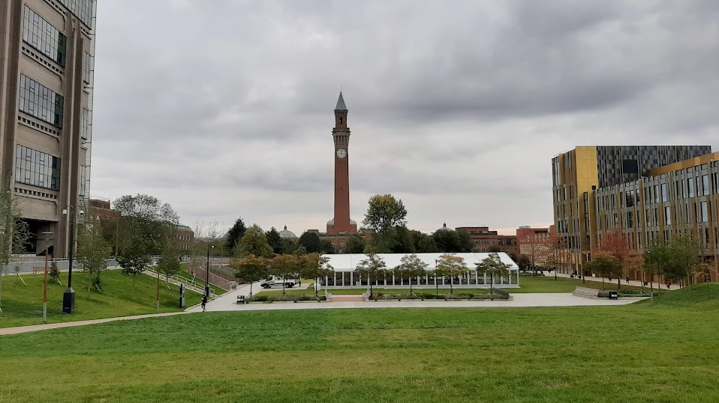
1st Day at University of Birmingham

Slide 4
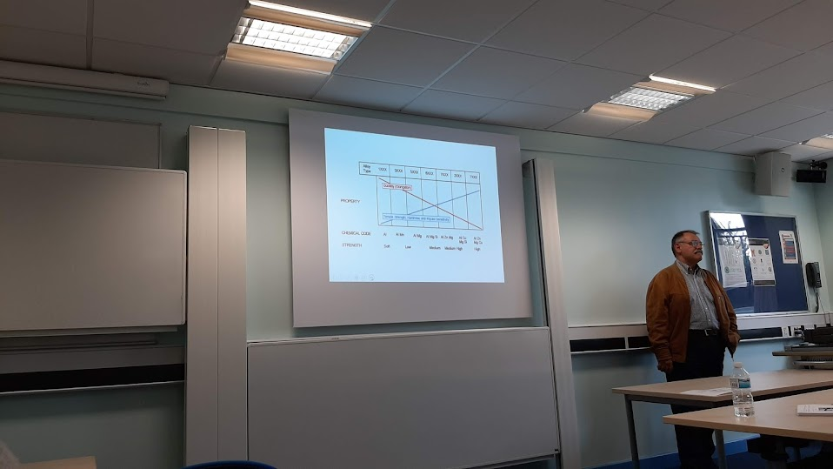
1st Class at University of Birmingham
Course Induction: Prof C Baniotopoulos (Lambis)

Slide 5
Course Summary
  Course Start Date: 30 September 2019
  Course End Date: 18 September 2020
  Total Credit Hours: 180 Credit
  Taught learning– 120 Credits
  Individual Research Project – 60 Credits
  No. of Semesters: 3
  Viva for MSc Dissertation: 14 September 2020
  Result Publication: 30 October, 2020
  Certificate Issued: 25 November, 2020

Slide 6
Course Summary
Sl. No. | Module Name | Credits
01 | Advanced Structures & Design | 20
02 | Experimental & Numerical Techniques in Structural Engineering | 20
03 | Forensic Engineering | 20
04 | Foundation Engineering | 20
05 | Seismic Engineering | 20
06 | Structural Engineering & Practice (SEP) | 20
07 | Individual Research Project/ Dissertation | 60
 | Total = | 180

Slide 7
Module 1: Advanced Structures & Design
Total Credit: 20
Total Sub-Module: 3
Date of Starting: September 30, 2019
Assessment Type: Written Exam (3 hours)
Date of Exam: October 25, 2019

Slide 8
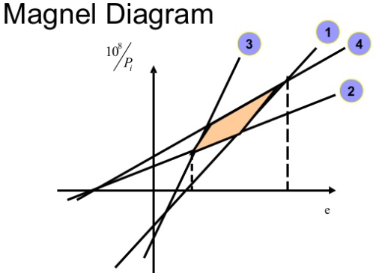
Module 1: Advanced Structures & Design
1.1 Bridge Maintenance & Management
  Deterioration
  Bridge Inspection & Diagnosis
  Maintenance & Repair Options
  Repair Products
1.2 Prestressed Concrete Structures
  Concept, Analysis, Magnel Diagram
  Limit State Design
  Response 2000
1.3 Design of Aluminium Structures
  Structural Aluminium in Bridges
Permissible zone

Slide 9
Module 1: Advanced Structures & Design
1.3 Design of Aluminium Structures
  Boats, Ships, Aircrafts, Railway, Cladding, Windows Facades
  Structural Aluminium in Bridges
Sweden, 2013

Slide 10
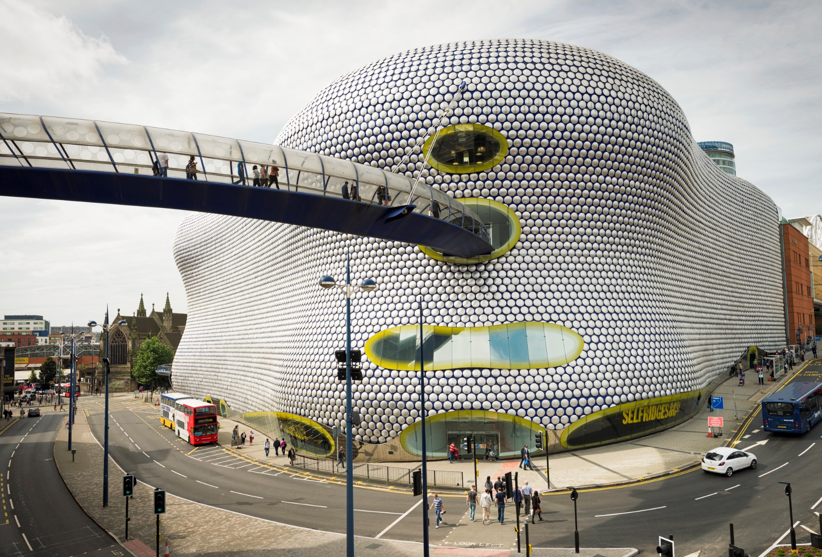
Module 1: Advanced Structures & Design
1.3 Design of Aluminium Structures
Bull Ring Shopping Centre, Birmingham, UK

Slide 11
Module 1: Advanced Structures & Design
1.3 Design of Aluminium Structures
Light Weight
Corrosion Resistance
Ductile
Wide range of alloys
Comparison of Mechanical Properties

Slide 12
Module 2: Experimental & Numerical Techniques
Total Credit: 20
Date of Starting: October 28, 2019
Assessment Type: Report Writing
Topics Covered:
  Introduction to Eurocode 9
  Case Study on Physical testing and NLFE analysis of aluminum Beams
  Local Buckling
  Introduction to Finite Elements
  NLFE modelling using Abaqus
  Physical Testing of Aluminum Beams

Slide 13
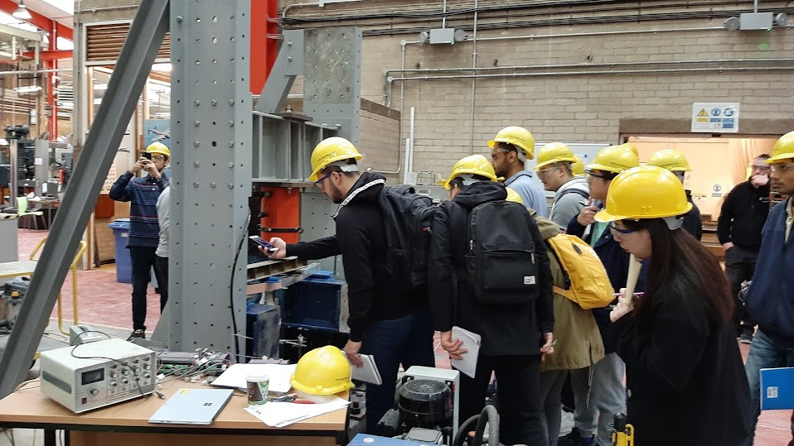
Module 2: Experimental & Numerical Techniques

Slide 14
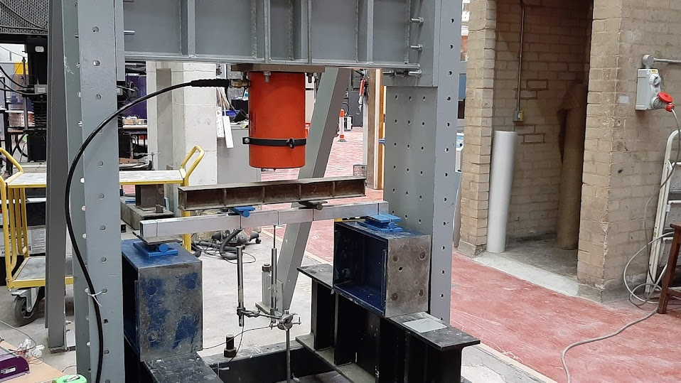
Module 2: Experimental & Numerical Techniques

Slide 15
Module 2: Experimental & Numerical Techniques

Slide 16
Module 2: Experimental & Numerical Techniques
Final Report

Slide 17
Module 3: Forensic Engineering
Total Credit: 20
Date of Starting: December 02, 2019
Assessment Type
  Group Project Presentation (30%)
    Millennium Bridge, London
  Individual Report (70%)
    RCC Multi-Storied Car Park Building Collapse

Slide 18
Module 3: Forensic Engineering
  Presentation: 6 Topics for 6 Groups

Slide 19
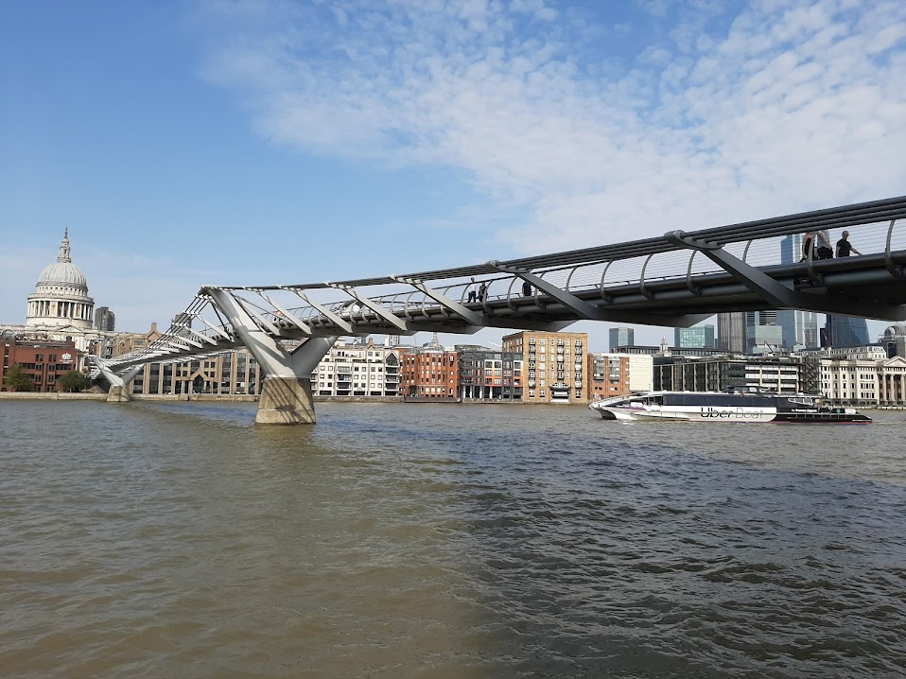
Module 3: Forensic Engineering
  Millennium Bridge, London, UK

Slide 20
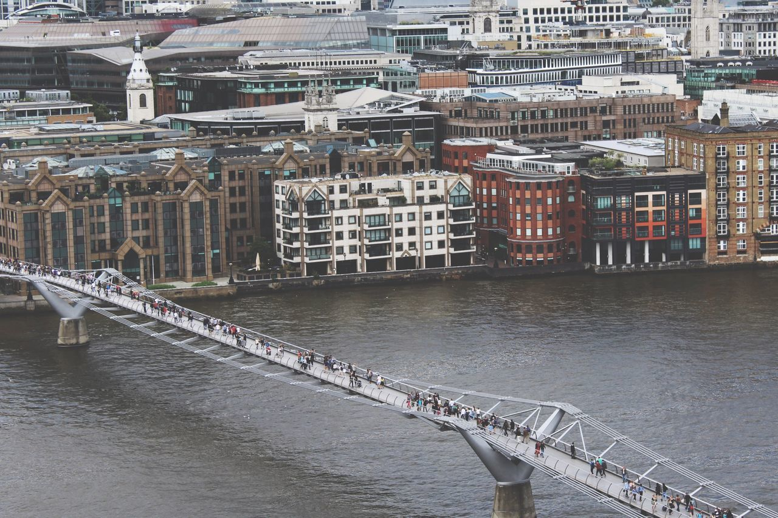
Module 3: Forensic Engineering

Slide 21
Background
Module 3: Forensic Engineering
Why the London Millennium Bridge wobbled
Bridge was designed in 1996
  AASHTO standard.
  Structure is divided into super structure and the substructure
  Sagging of the bridge in the main span was 2.3m.
  Four piers of diameter 6m and four caissons of length 18m.
  For south abutment is 16 bored cast in situ concrete piles of 2.1m diameter and it is 28m long with a 3m deep pile cap
Bridge opened on 10 June 2000.
  Around 80,000 to 100,000 people used the bridge on the first day
  unexpected lateral movements/vibrations where observed.
  Movement ranged between a frequency of 0.5Hz to 1Hz.
Officials closed the bridge on 12 June 2000.
Bridge re-opened on February 22, 2002

Slide 22
Results of the case study
Module 3: Forensic Engineering
  Synchronized swaying
Effects of external forces
Effects of pedestrians
Critical Number of pedestrians
  Previous observations
Bridge Frequency of 1.3 Hz.
NEC Link Bridge, Birmingham
  Final decision
Design Rectification
Increased Stiffness

Slide 23
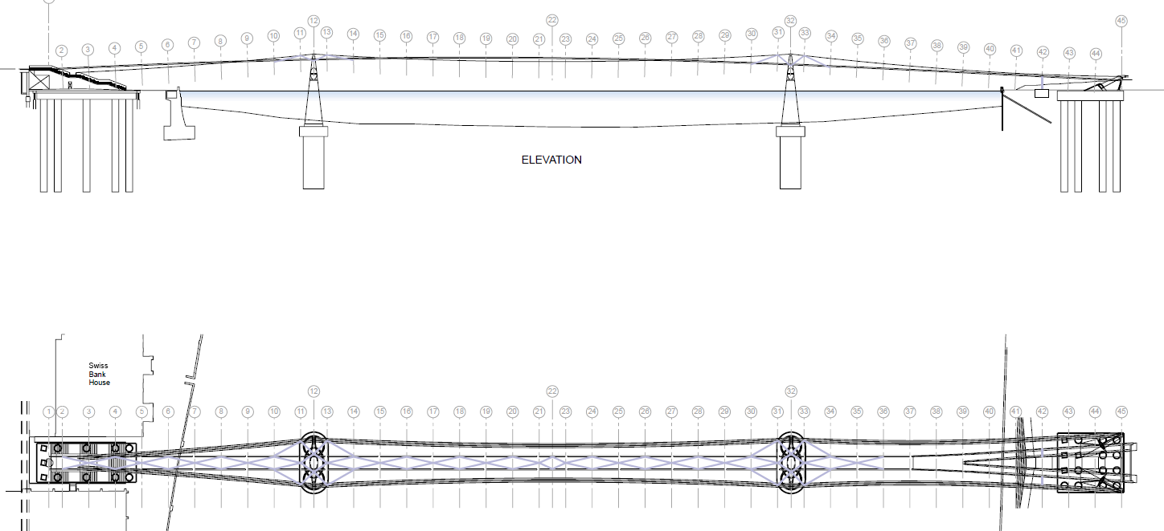
Plan & Elevation of Bridge showing various Dampers
Module 3: Forensic Engineering
8 FVDs/ pier
8 FVDs/ pier
4 FVDs on South Bank
17 Chevron FVDs under deck

Slide 24
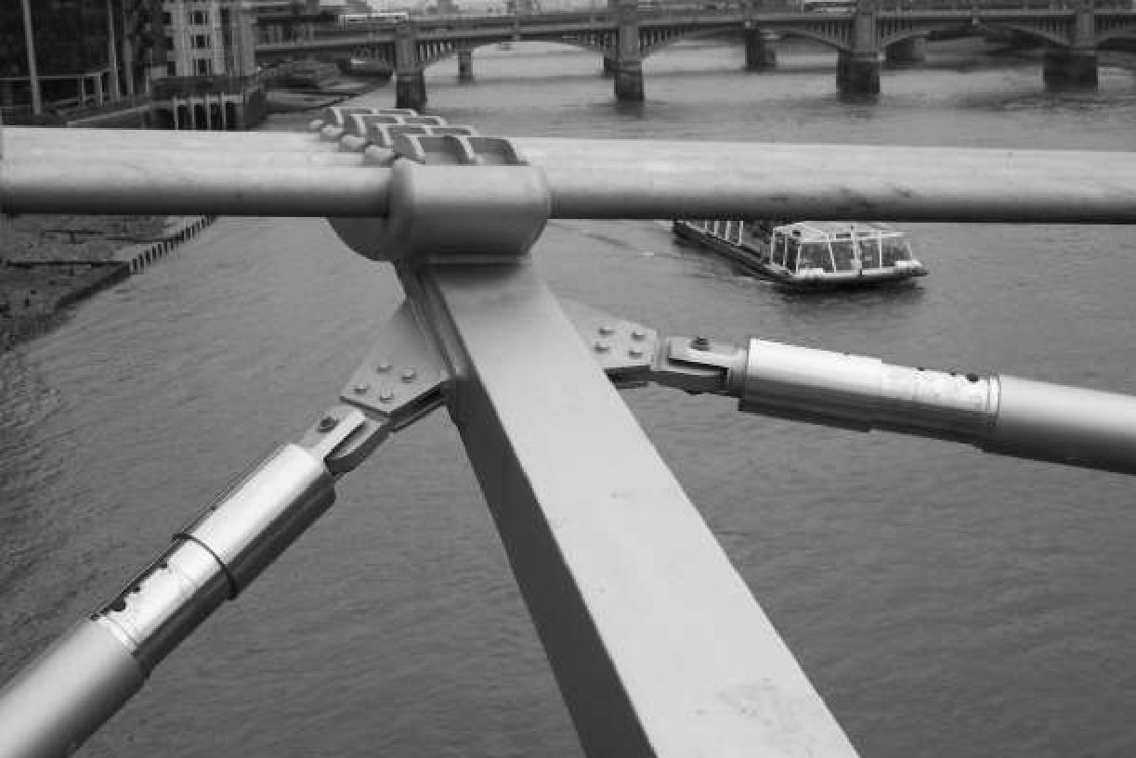
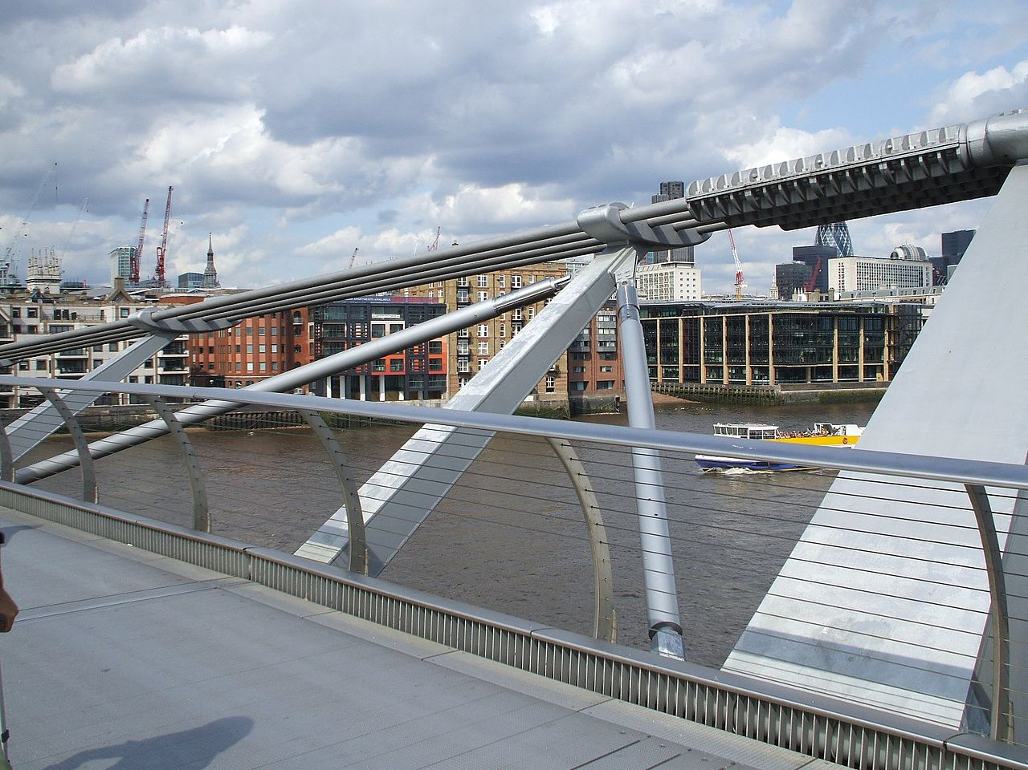
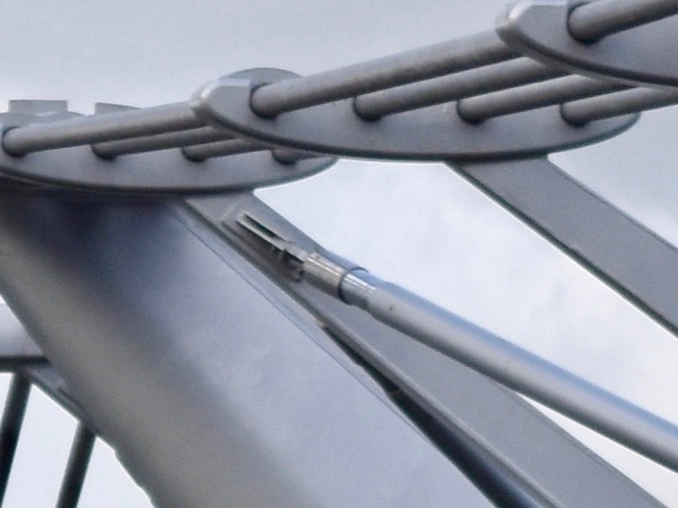
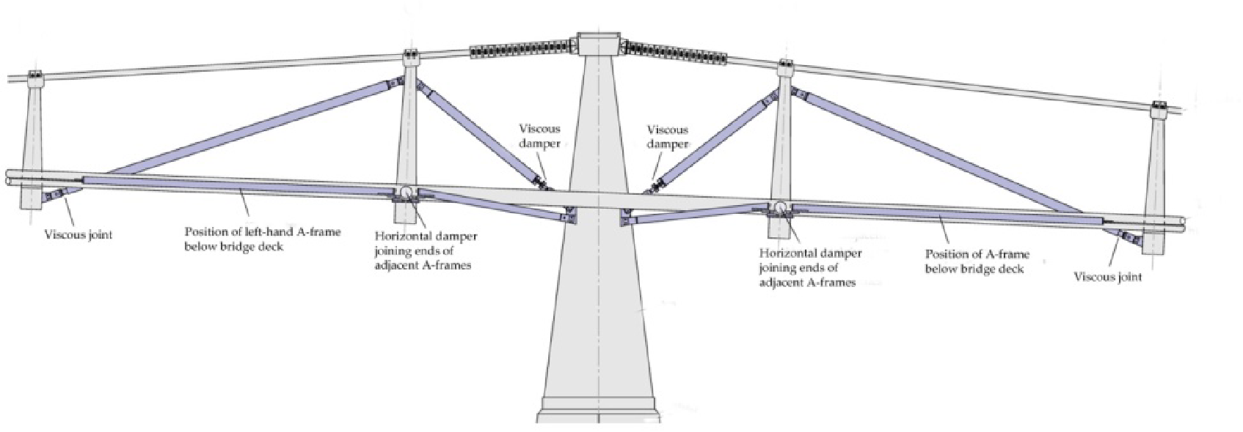
Installed Pier dampers
Module 3: Forensic Engineering
Dampers attached to arm of a saddle
Dampers attached to arm of a saddle (Another Angle)
Moving end of Pier Damper

Slide 25
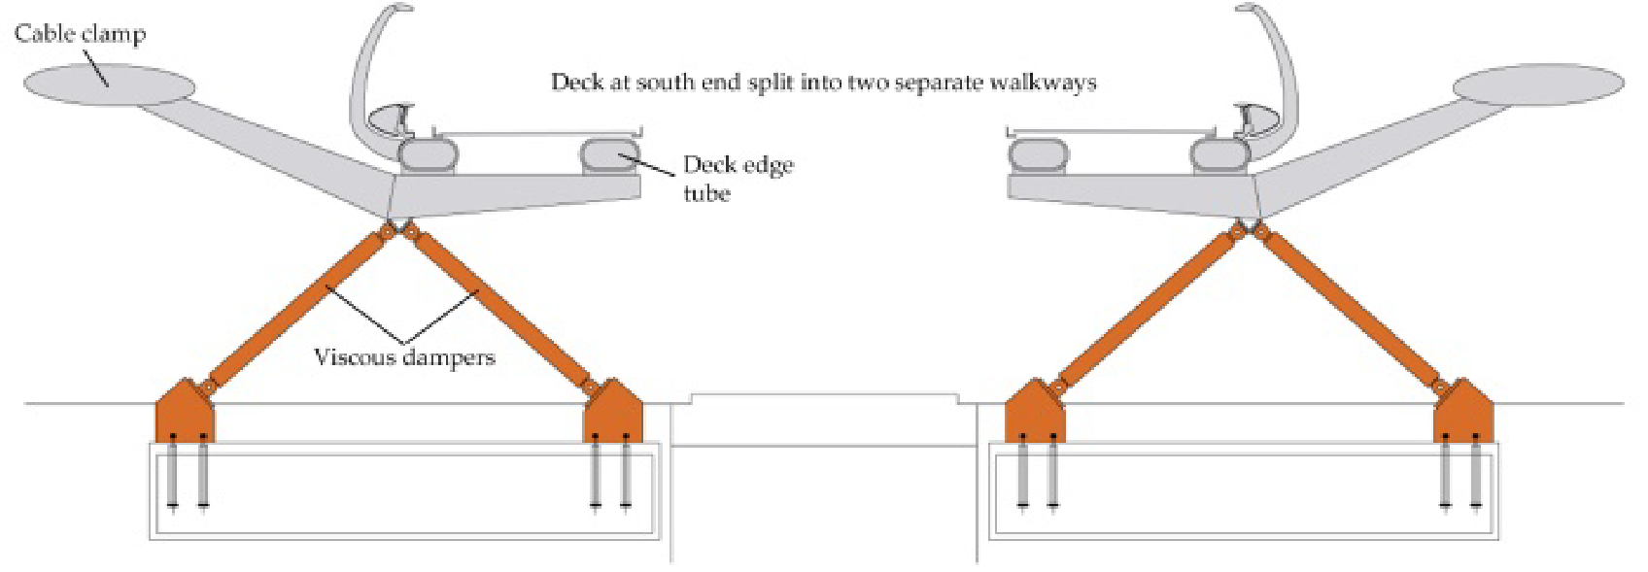
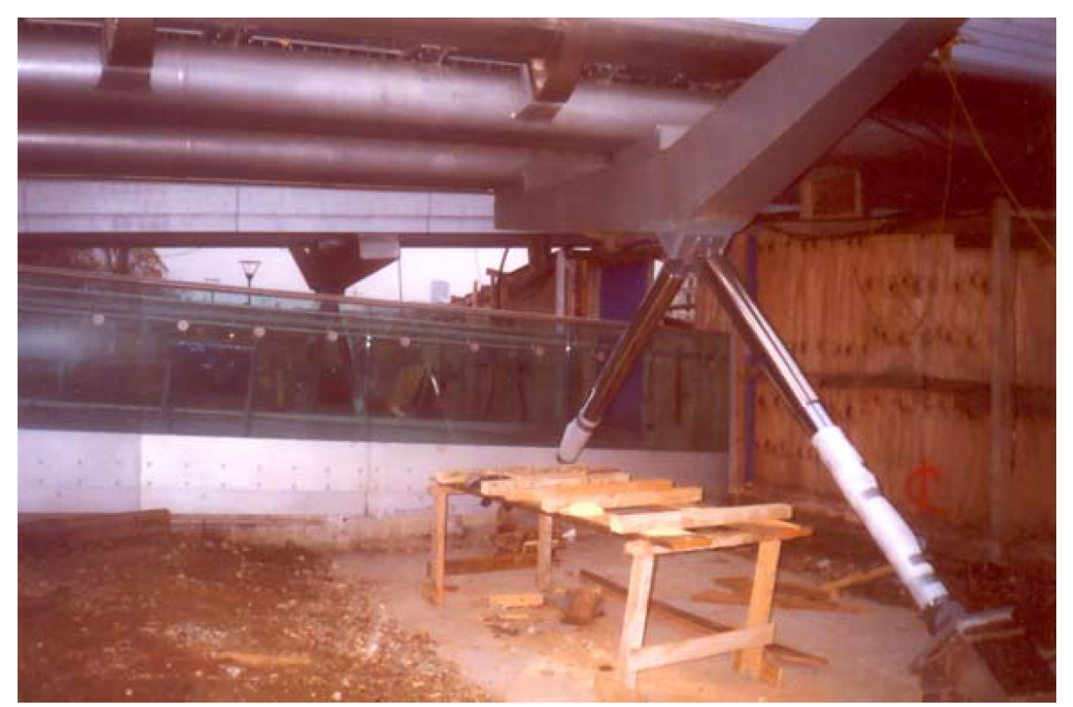
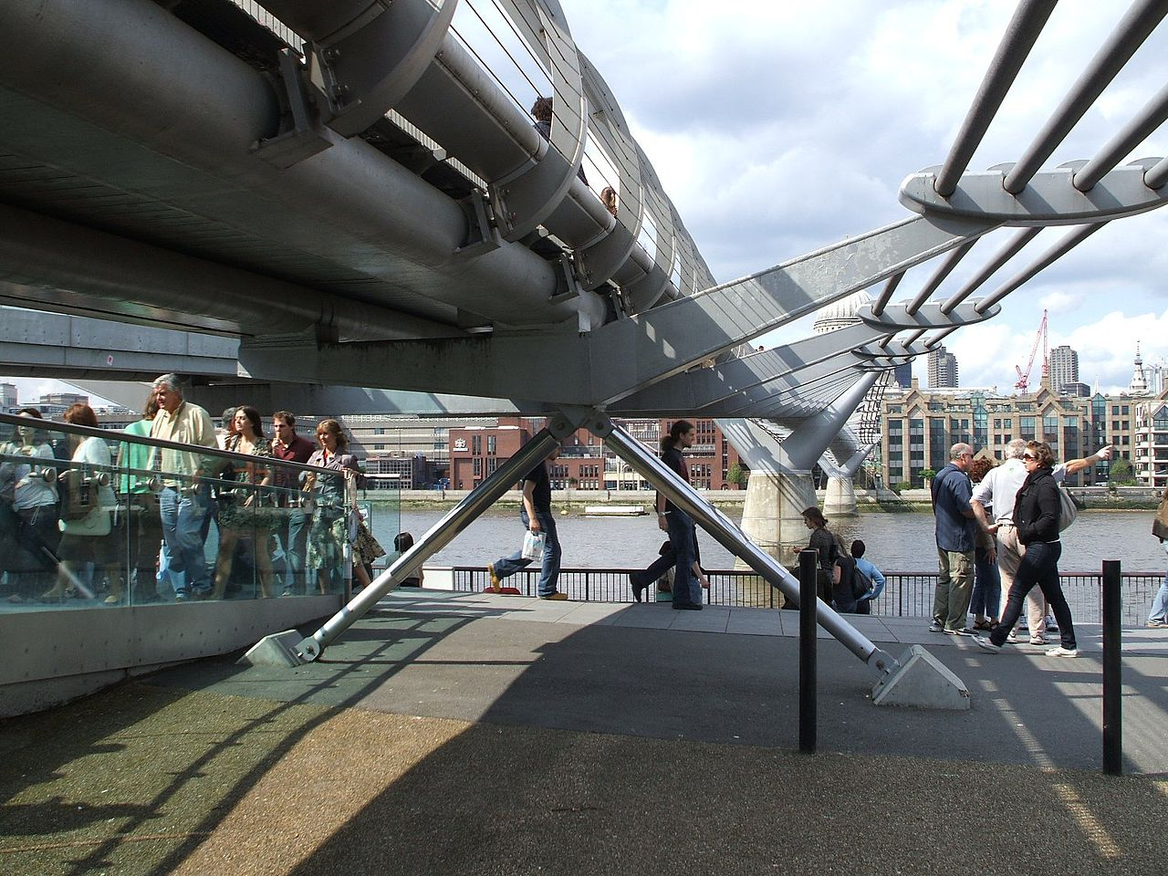
Vertical to Ground Dampers
Module 3: Forensic Engineering
During Installation
After Installation

Slide 26
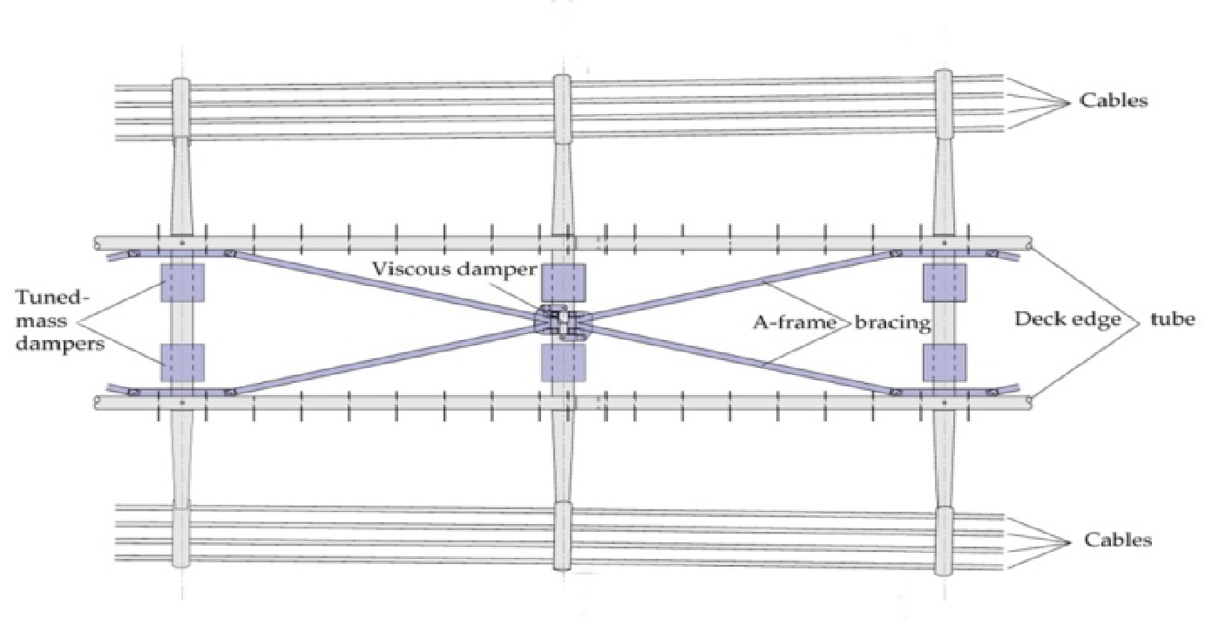
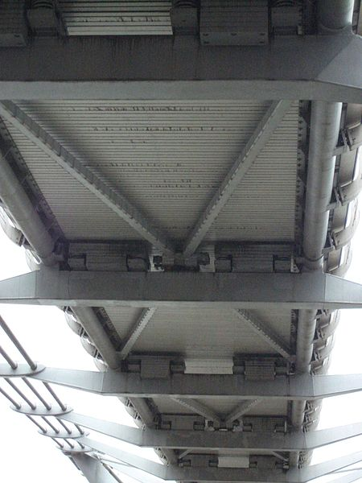
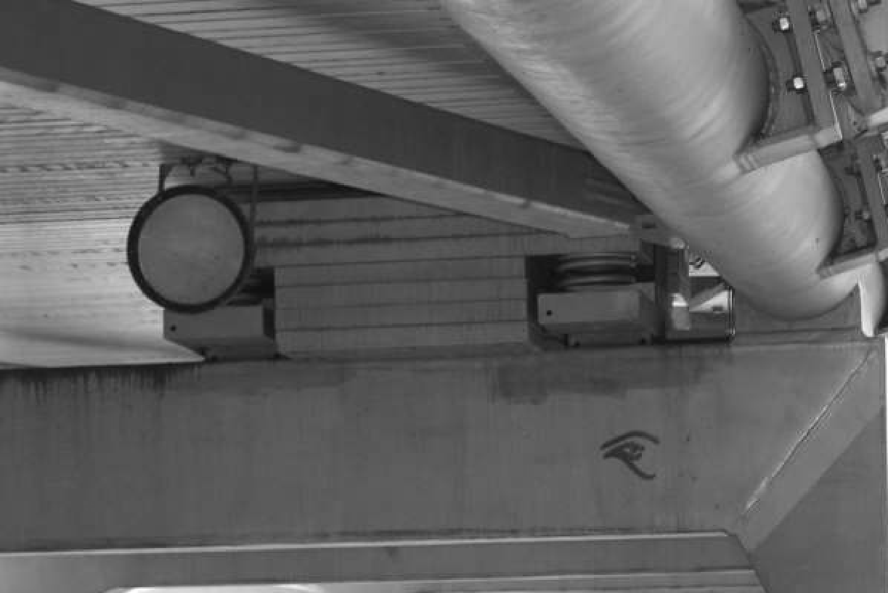
Deck showing Chevron & Tuned Mass Dampers
Module 3: Forensic Engineering
Long V-shaped Chevron braces directly under the deck panel
To control lateral movement
17 Numbers

Slide 27
Lesson Learnt & Changes to Working Practices
Module 3: Forensic Engineering
Synchronous lateral excitation from pedestrians is a phenomenon to be accounted for in new design and retrofit.
Under heavy pedestrian traffic, resultant forces in the horizontal direction governs the design with respect to serviceability more than the corresponding vertical component.
For new-build and existing structures, ensure that lateral components carry a natural frequency > 1.3 Hz between spans.
Get the design right in the first place because retrofitting work is costly and potentially suicidal to one’s career.
  (Original £18.2 m, Retrofitting £5m, + 27.5%)
Included in the next edition of British Bridge Design Standard BD 37/01.
Notes:
DETR – Department of Environment, Transportation and the Regions
IABSE – International Association for Bridge and Structural Engineering

Slide 28
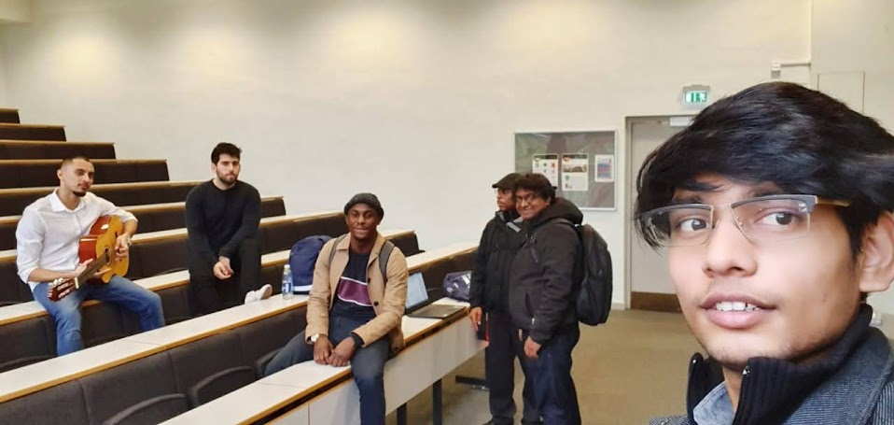
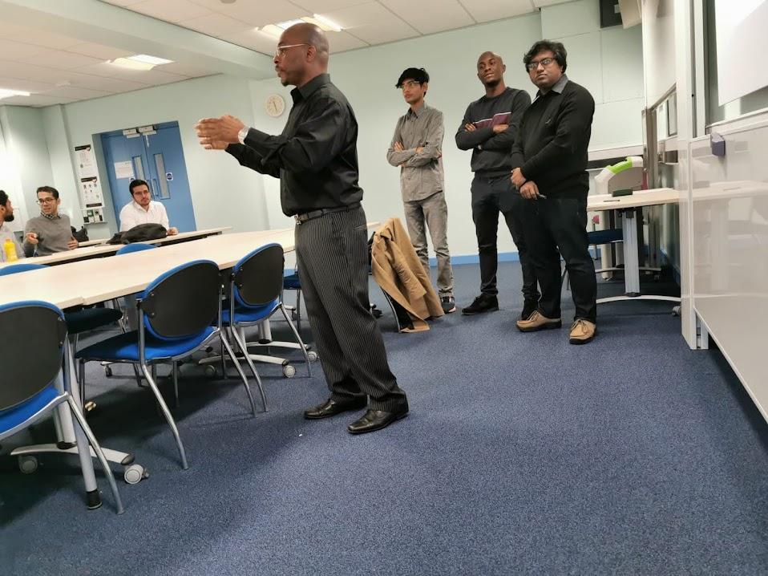
Module 3: Forensic Engineering
  Presentation Rehearsal
The Team:
Blnd Aga
Stephen Ola Agbebi
Sanket Chavhan
Mohammad Emad Khursheed
Tapas Chowdhury
George Elwin Ulric Dawson
  Final Presentation

Slide 29
Module 4: Foundation Engineering
Total Credit: 20
Date of Starting: January 12, 2020
(Lecture note given 1 week earlier for self study)
Assessment Type: Written Exam (3 Hours)
Exam Date: January 31, 2020

Slide 30
Module 4: Foundation Engineering
4.1 Shallow Foundation
  Various types of foundations
  Settlement calculations
4.2 Deep Foundation
  Pile types and construction methods
  Single/group pile calculations for different soil conditions
  Faults in Piles & Pile testing
  Pile design for lateral loading, Fender, Batter, Anchor & Dolphin Piles
4.3 Ground Improvement
  Dynamic compaction, Compaction grouting, stone column, PVD, Vibro- compaction, Vibro-replacement, Vibro-cement columns (VCCs)
4.4 Soil Dynamics & Liquefaction
  Subgrade reaction, period, resonance, damping ratio, damped natural frequency

Slide 31
Module 5: Structural Engineering Practice (SEP)
Total Credit: 20
Date of Starting: February 02, 2020
Assessment Type:
  Written Exam (2 Hours), Open book (50%)
    Contracts & Procurement (25%)
    Structural Materials (25%)
  Coursework (Individual Written Assignments) (50%)
    Construction systems & Techniques and Commercial and financial constraints and their impact on Structural Engineering Practice (25%)
      Coursework on a Theatre
    Health & Safety –requirements and legislation (12.5%)
      Coursework on Bridge Removal
    Environmental and Sustainability Issues and Legislation (12.5%)
      Coursework on Environment Impact Assessment of an Onshore Wind Farm
Exam Date: February 28, 2020

Slide 32
Module 6: Seismic Engineering
Total Credit: 20
Date of Starting: March 02, 2020
Assessment Type:
  Group Coursework - (20%)
  Individual Coursework - (20%)
  Final Exam (3 Hours) - 60%
Exam Date: March 27, 2020

Slide 33
Module 6: Seismic Engineering
6.1 Structural Dynamics
  SDOF, MDOF systems
  Vibrations of SDOF & MDOF systems
6.2 Earthquake Engineering
  Response Spectrum
  Numerical Evaluation of Dynamic Response
  Spectral Analysis
  Design of structural for Earthquake Resistance
6.3 Tuned Mass Dampers
  Undamped/ Damped Two Degree freedom system
  Relative motion of main and absorbed masses
  Damped main and auxiliary system

Slide 34
Module 7: Individual Research Project
Selection Criteria:
  Home Influence
  Bridge Structure
  Steel Structure
Option 1:
Optimization of Progressive Cantilever PSC Box Girder Bridge for 1st and 2nd Class Rivers of Bangladesh
Option 2:
Selection of the most appropriate structural form for the replacement of existing Iron Bridges in the Barisal Regions of Bangladesh
Option 3:
Structural Analysis and Design of Offshore wind turbine (OWT) tower under wind, wave and seismic loading in the Bay of Bengal Environment

Slide 35

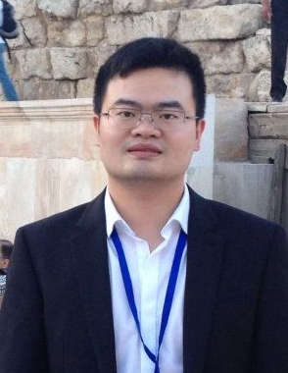
MSc Individual Research Project 2019-20
Structural Analysis and Design of Offshore wind turbine (OWT) tower under wind, wave and seismic loading in the Bay of Bengal Environment
  Supervisor
  Research Guide
  Professor
  Charalampos Baniotopoulos (Lambis)
  246 publications
  Chair of Sustainable Energy Systems
  http://ccb.civil.auth.gr/
  Dr. Yu Hu
  Post-doctoral Researcher
  Shanghai Jiao Tong University
  Assistant Professor
  Konstantinos Skalomenos (Kostas)

Slide 36
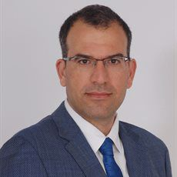
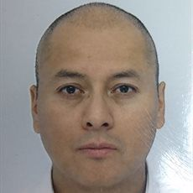
MSc Individual Research Project 2019-20
Structural Analysis and Design of Offshore wind turbine (OWT) tower under wind, wave and seismic loading in the Bay of Bengal Environment
  Reviewer 1
  Reviewer 2
  Dr. Konstantinos Skalomenos (Kostas)
  k.skalomenos@bham.ac.uk
  Dr. Pedro Martinez-Vazquez
  p.vazquez@bham.ac.uk

Slide 37
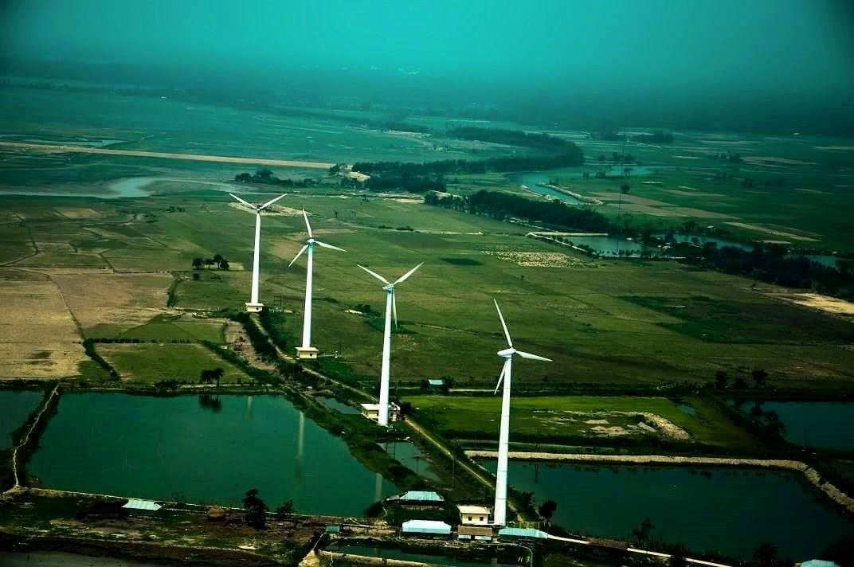
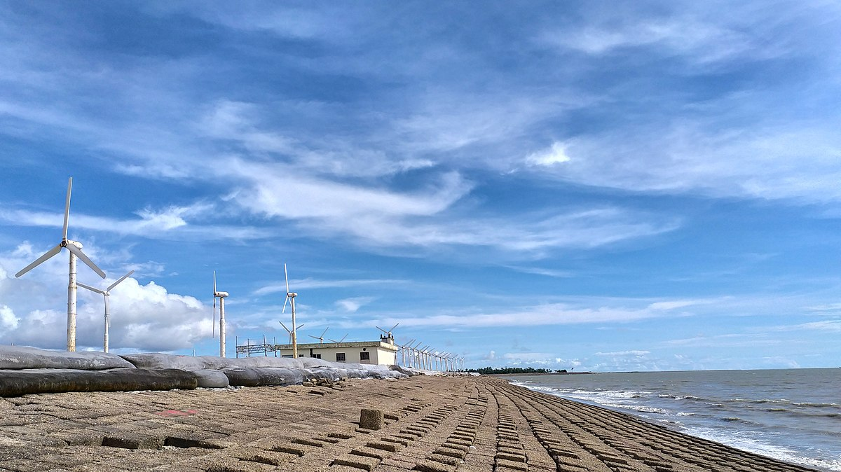
Reasons behind choosing this topic
  Muhuri Dam Project, Sonagazi, Feni. (Capacity: 0.9 MW, 4 turbines, 225 KW each)
  Kutubdia Island, Cox’s Bazar (Capacity: 1 MW, 50 turbines, 20 KW each)
  Ongoing Onshore Projects: 10 Nos. with 358 MW capacity (Source: SREDA)
  No offshore WT
Sonagazi, Feni
Kutubdia, Cox’s Bazar

Slide 38
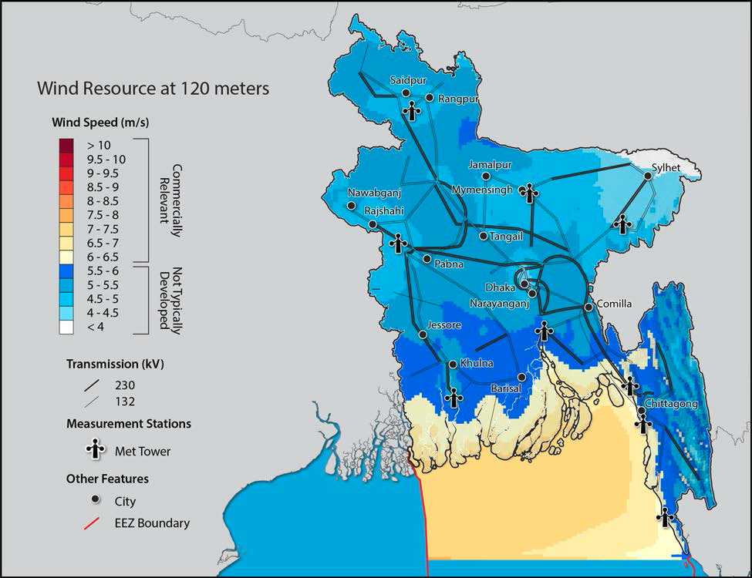
Reasons behind choosing this topic
  Assessing the Wind Energy Potential in Bangladesh, 2021 (USAID, NREL)

Slide 39
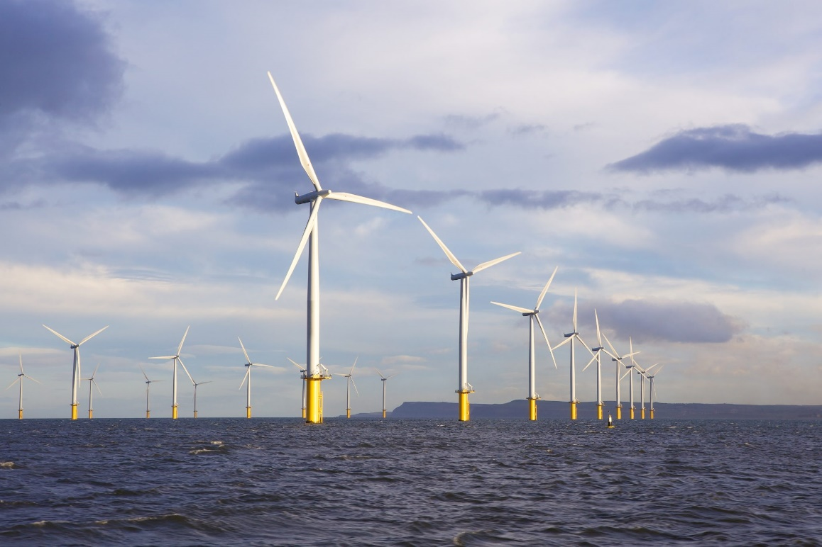
Reasons behind choosing this topic
Why Offshore WT is Effective in Bangladesh:
  Wind Energy is relatively high and commercially relevant beyond 80m height.
  Wind Tower of 80 to 120m height is the most suitable option at six coastal zones (574 km coastline) of Bangladesh (Saifullah, et al., 2016)
  Waterway transportation might be the main strength to transport of heavy and large components in the Coastal region of Bangladesh (Faijer & Arends, 2017)

Slide 40
Challenges to Design OWT Tower in the Bay of Bengal Env.
  100m Wind Turbine Tower in the Bay of Bengal Environment
  (Specially at Kuakata, Patuakhali)
  Main Challenge: Design Speed to withstand the tropical cyclones
  Southern regions of BD are hit by tropical cyclones almost every year due to funnel shaped geographical location.
  Avg. speed of cyclones is around 80m/s (not present in the IEC 61400 standard up to 3rd Ed)

Slide 41
Challenges to Design OWT Tower in the Bay of Bengal Env.
Summary of Severe cyclones in Bangladesh for last 20 years
Sl. No. | Year | Name of Cyclone | Category of Cyclone on the SSHS (Saffir–Simpson hurricane scale) | Wind Speed (1-minute sustained) (Km/hr)
01 | 2020 | Amphan | Category 5 | 260
02 | 2019 | Fani | Category 4 | 250
03 | 2019 | Bulbul | Category 2 | 155
04 | 2009 | Alia | Category 1 | 120
05 | 2008 | Nargis | Category 4 | 215
06 | 2007 | Sidr | Category 5 | 260
  India: 80.0 m tall WT tower: designed using 20m/s (local data), not consider the tropical cyclone speed, assuming thin structure (Umesh, et al., 2016)
  Japan: Class-T specifications are followed by Japan, Taiwan, Korea & China as approved class was absent in IEC61400-1, 2005

Slide 42
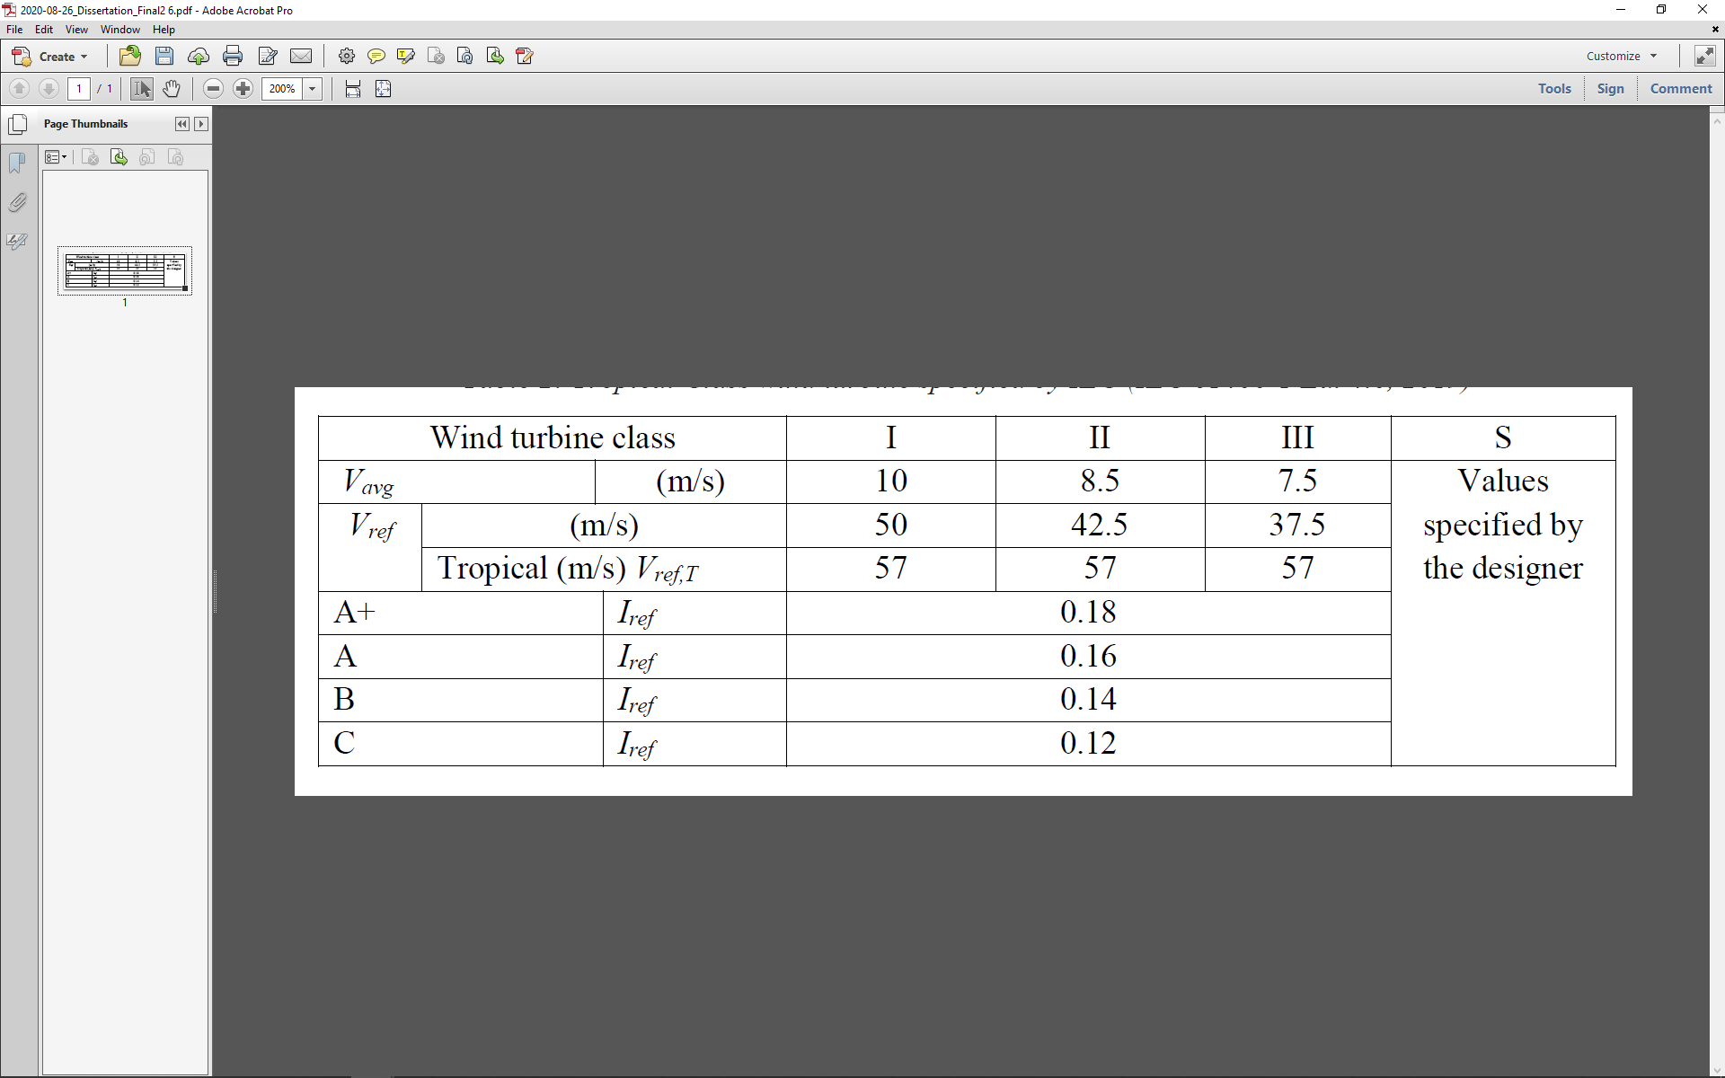

Challenges to Design OWT Tower in the Bay of Bengal Env.
Tropical Class wind turbine specified by IEC (IEC 61400-1 Ed. 4.0, 2019)
  Tropical Cyclone class has included in the recent version of IEC61400-1, 2019
V_{e50} = 1.4 V_{ref,T} $≈$ 80 m/s.

Slide 43
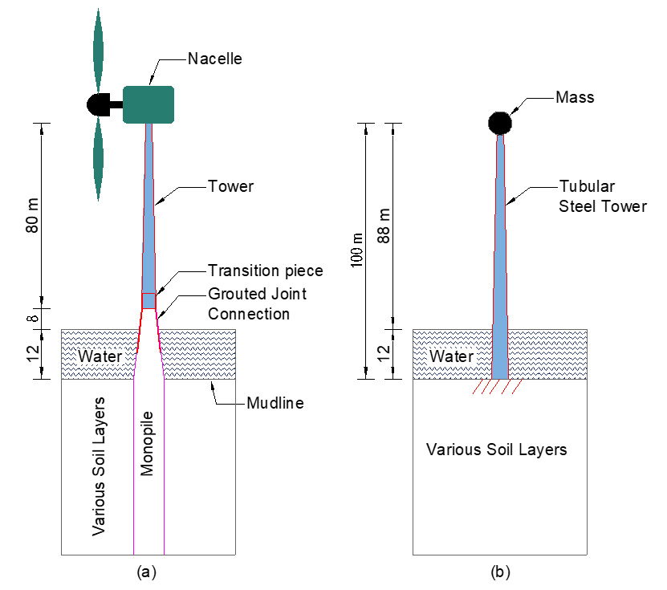
OWT Tower Analysis
-

Slide 44
Assumptions
  FE model of tower is fully cantilever, fixed at the base
    thin-walled circular cross section
    carrying horizontal and vertical concentrated forces at its free end
    distributed wind load along its height.
  Tower material is linearly elastic, isotropic and homogeneous.
  Distributed aerodynamic loads are occurred due to wind, wave and earthquake forces.
  The support of the tower is assumed as rigid.
  The material property of structural steel of the tower should remain in the elastic zone under any load conditions.

Slide 45
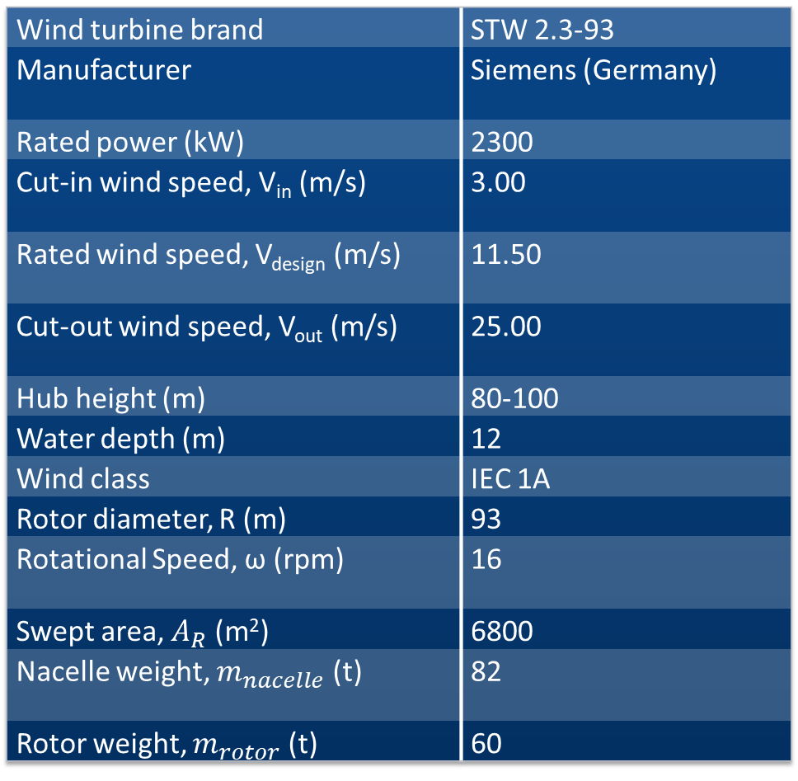
Technical Specification of Wind Turbine
Wind turbine brand | STW 2.3-93
Manufacturer | Siemens (Germany)
Rated power (kW) | 2300
Cut-in wind speed, V_{in} (m/s) | 3.00
Rated wind speed, V_{design} (m/s) | 11.50
Cut-out wind speed, V_{out} (m/s) | 25.00
Hub height (m) | 80-100
Water depth (m) | 12
Wind class | IEC 1A
Rotor diameter, R (m) | 93
Rotational Speed, ω (rpm) | 16
Swept area, $A_{R}$ (m²) | 6800
Nacelle weight, $m_{nacelle}$ (t) | 82
Rotor weight, $m_{rotor}$ (t) | 60

Slide 46
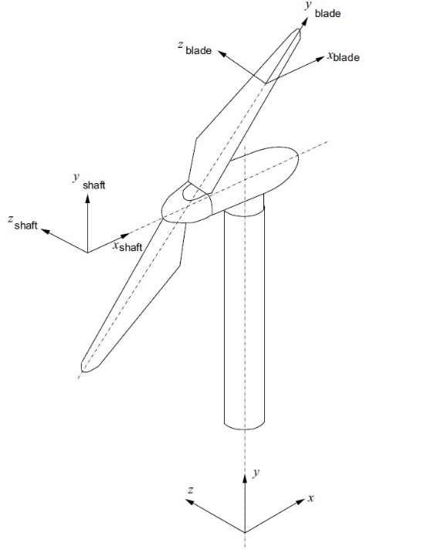
Modelling Space, Coordinate System & Elements for NLFE
  3D modelling Space
  Cartesian Coordinate system
  Used two NLFE Software
    Abaqus/ CAE 2019
    Staad.pro circular cross section
  4-node shell elements S4R are used in Abaqus
  4-node thin plate elements used in Staad.pro

Slide 47
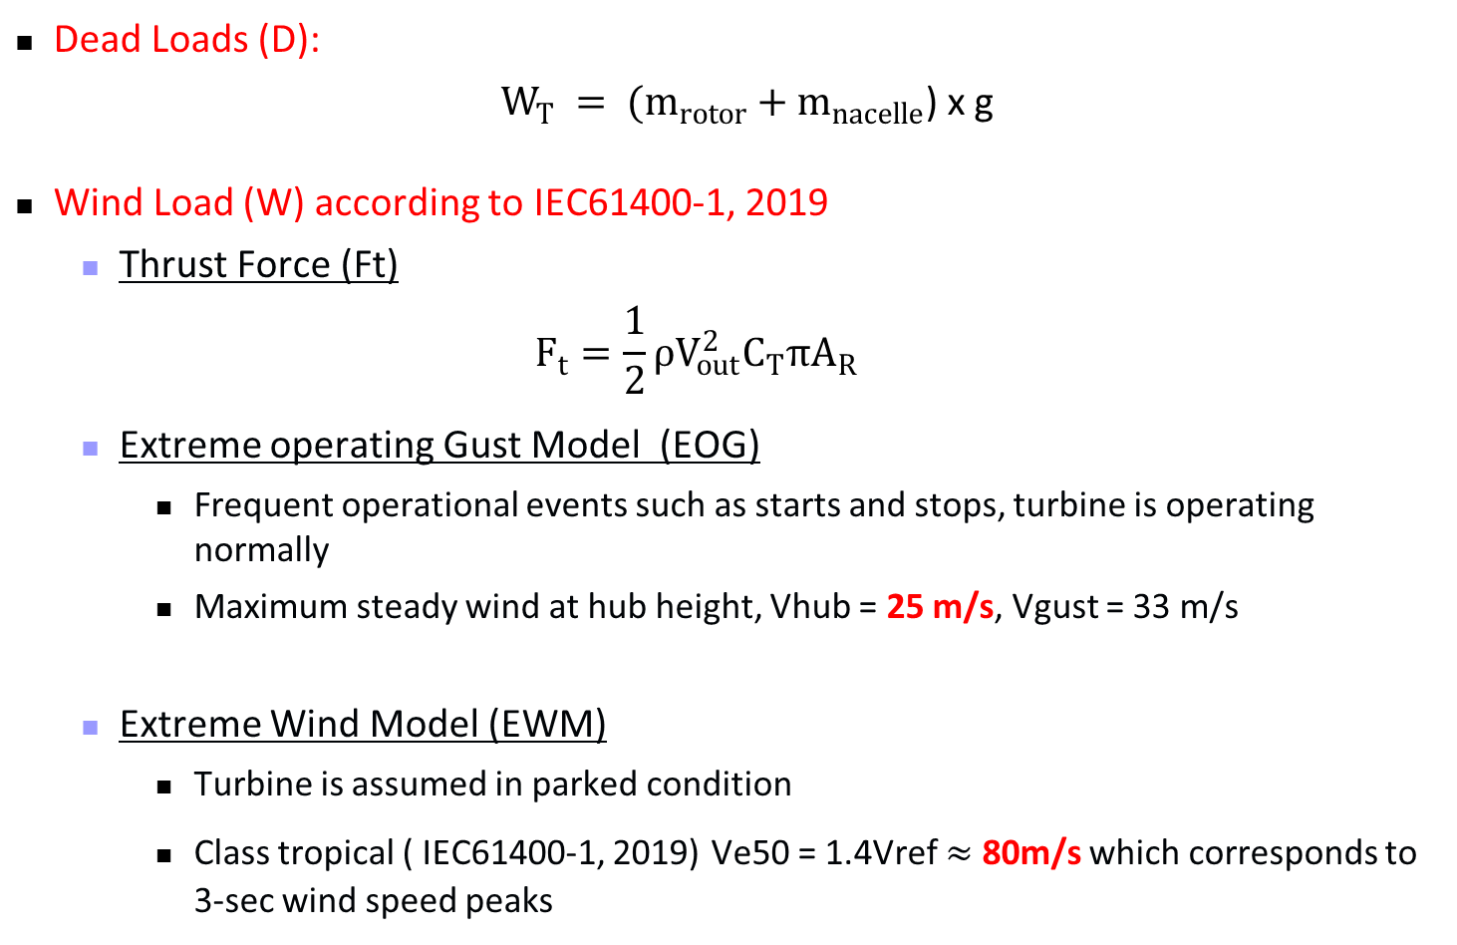
Load Calculations
  Dead Loads (D):
  $W_{T} = (m_{rotor}+m_{nacelle}$) x g
  Wind Load (W) according to IEC61400-1, 2019
    Thrust Force (Ft)
    $$F_{t}=\frac{1}{2}ρV_{out}^{2}C_{T}πA_{R}$$
    Extreme operating Gust Model (EOG)
      Frequent operational events such as starts and stops, turbine is operating normally
      Maximum steady wind at hub height, Vhub = 25 m/s, Vgust = 33 m/s
    Extreme Wind Model (EWM)
      Turbine is assumed in parked condition
      Class tropical ( IEC61400-1, 2019) Ve50 = 1.4Vref $≈$ 80m/s which corresponds to 3-sec wind speed peaks

Slide 48
Load Calculations
  Wind Load (W) Distribution

Slide 49
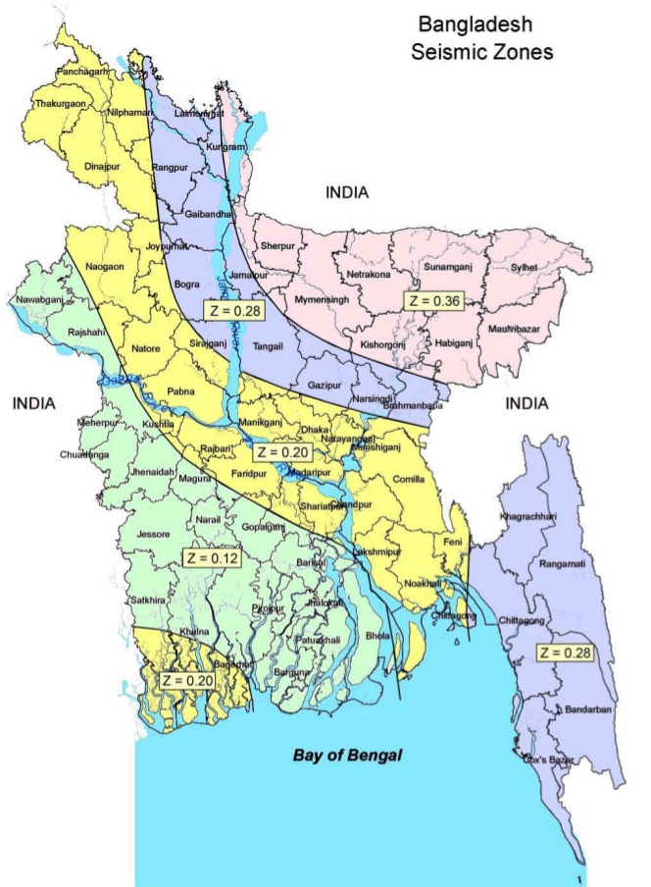
Load Calculations
  Earthquake Loads (E):
Parameters for response-spectra analysis:
Seismic Zone: Zone-I (Z = 0.12)
Soil Classification: SC (S = 1.15)
Material Damping: 5%
Importance Factor (I): 1.5
Normalized design acceleration response spectrum for SC soil type

Slide 50

Load Calculations
  Wave Load (F_{D}):
According to BNBC
Net Wave Force, $F_{D}=0.5γ_{w}C_{D}DH_{b}^{2}$
γ_{w} = unit weight of water (kN/m³)
H_{b} = breaking wave height (m)
D = diameter of tower (m),
C_{D} = coefficient of drag
= 1.75 for circular sections

Slide 51
Forces acting on the OWT Tower (Simplified)

Slide 52
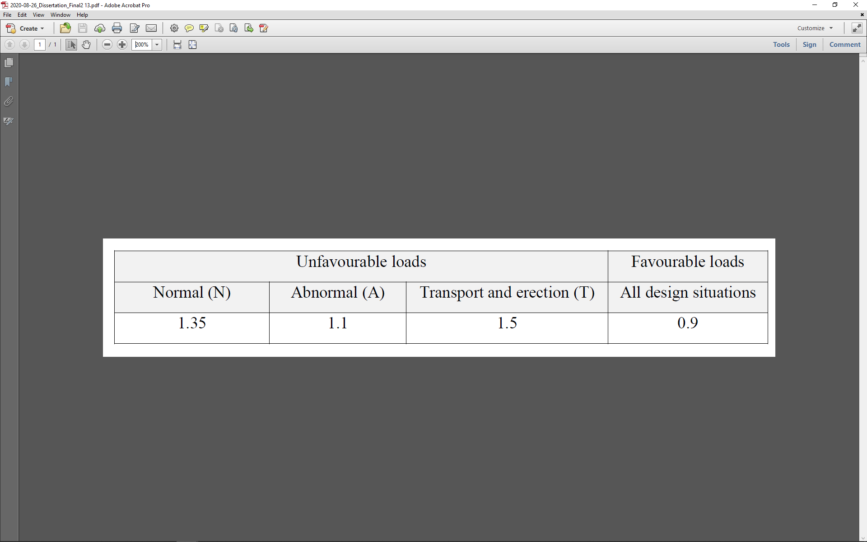
Load Conditions and Cases
Partial Safety factor for loads γ_{f} ( IEC61400-1, 2005)
The recommendations from BNBC has followed for all structural components but for wind turbine effects IEC 61400-1: 2019 specified load factors has used
Considered Design Load Cases:
DLC 1: 1.4D + 1.4W_{e50,EWM}
DLC 2: 1.2D + 1.6W_{e50,EWM} + 2.0F_{D}
DLC 3: 1.2D + 1.2W_{EOG} +1.35 W_{TF}
DLC 4: 1.2D + 1.0E
DLC 5: 1.0D+1.0W_{EOG} +1.0W_{TF} + 1.0F_{D}

Slide 53
Mesh Convergence Study
Mesh convergence diagram for Wind Turbine Tower
Elements Used: 6940 for Abaqus, 7200 for Staad.Pro

Slide 54
Model Validation
Comparison of analytical and numerical weights of the tower
Parameters | From Excel (kN) | From Abaqus Model (kN) | From Staad.Pro Model (kN)
Weight of Structure | 3013.62 | 3023.23 | 3013.017
Mean | 3016.62
Standard Deviation, | 4.679
Coefficient of variation, C_{v} (%) | 0.155%
Comparison of analytical and numerical natural frequencies of the tower
Parameters | From Excel by Eq. (10) (Hz) | From Abaqus Model (Hz) | From Staad.Pro Model (Hz)
1st natural frequency | 0.614 | 0.587 | 0.593

Slide 55
Analysis of OWT Steel Tower Response
Selecting Gross Geometry by constant top dia. And changing base diameter
Optimize the Geometry by changing Shell thickness and stiffening ring
Checking each structure under four constraint criteria
a) Lateral Sway, b) Ultimate Stress,
c) Buckling Analysis & d) Modal frequency

Slide 56
Results and Discussion

Slide 57
Results and Discussion

Slide 58
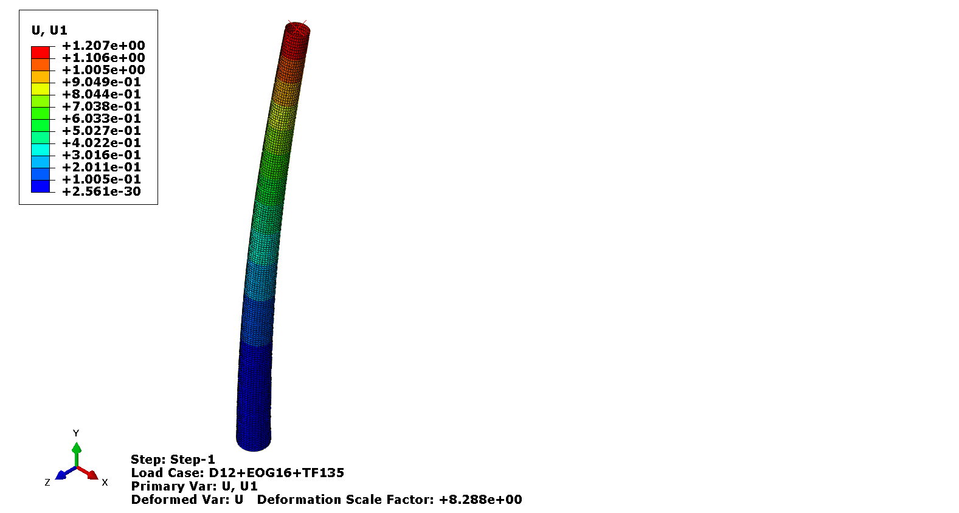



Results and Discussion
Lateral Deflection Check
  Allowable Value
$$δ_{max}≤1.25\frac{L_{Tower}}{100}$$
$δ_{max}$ = 1.25m
$δ_{max, design}$ = 1.207m

Slide 59
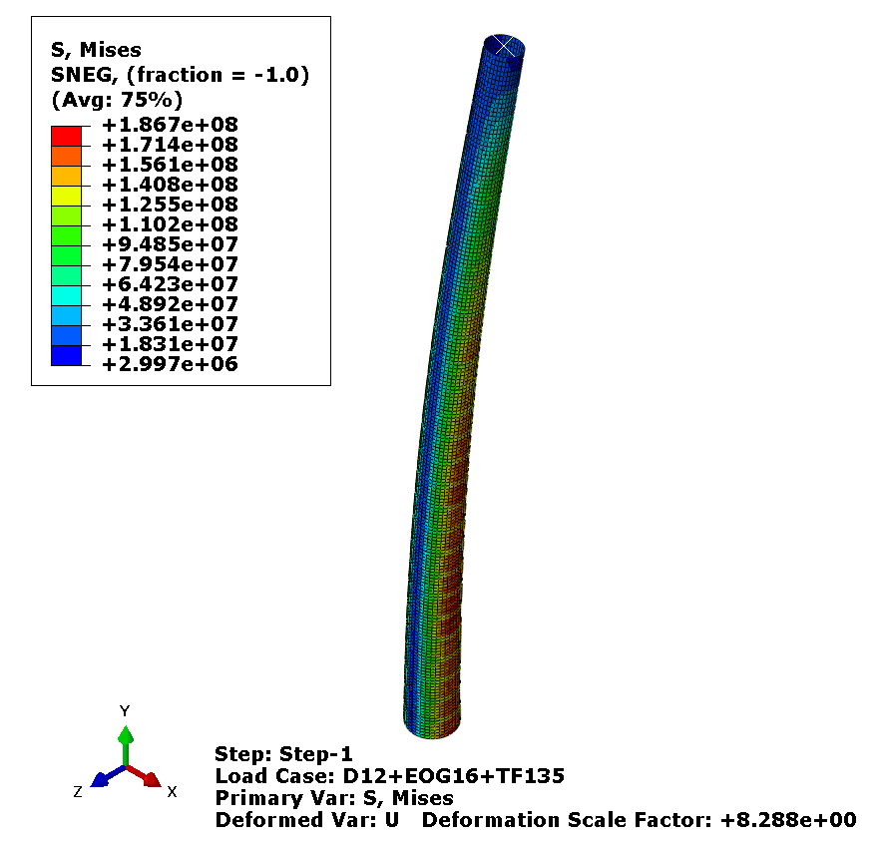
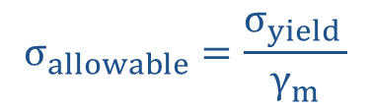

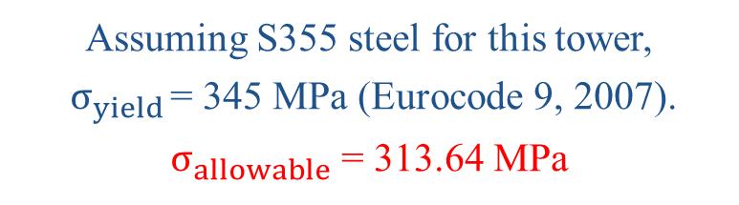
Results and Discussion
Ultimate Stress Check
  Allowable Value
$$σ_{allowable}=\frac{σ_{yield }}{γ_{m}}$$
Assuming S355 steel for this tower,
$σ_{yield }$= 345 MPa (Eurocode 9, 2007).
$σ_{allowable}$ = 313.64 MPa
$σ_{max, design}$ = 186.7 MPa

Slide 60
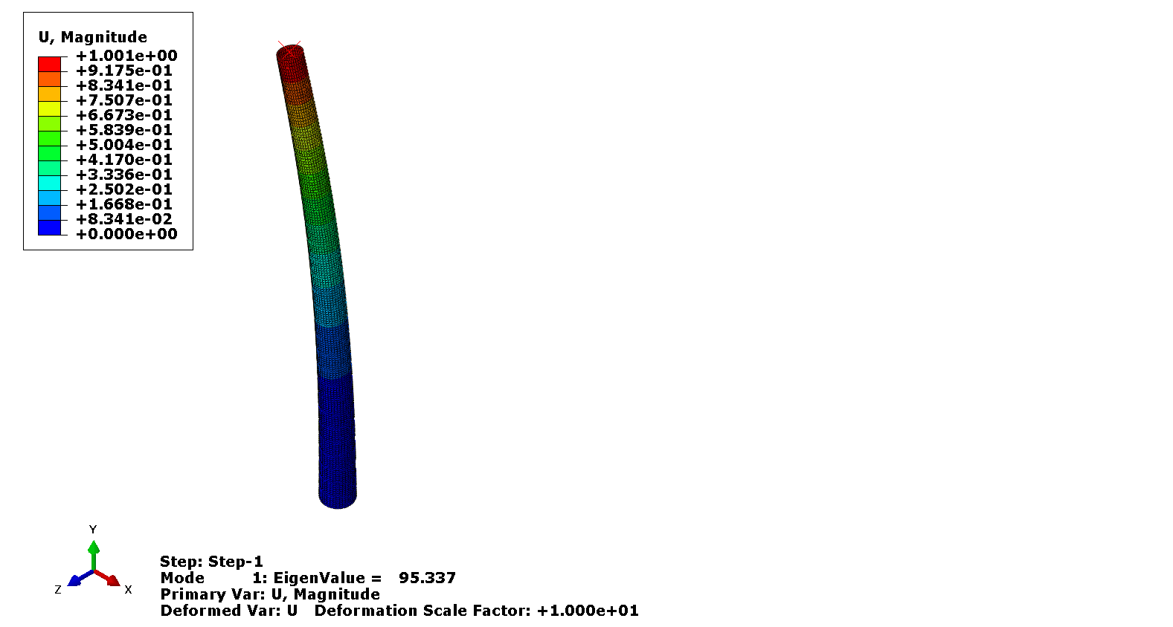
Results and Discussion
Buckling Analysis
According to the design standard (DNV GL AS, 2018), in this study, the minimum load multiplier is assumed as 1.4.
Load Multiplier = 95.337 MPa

Slide 61
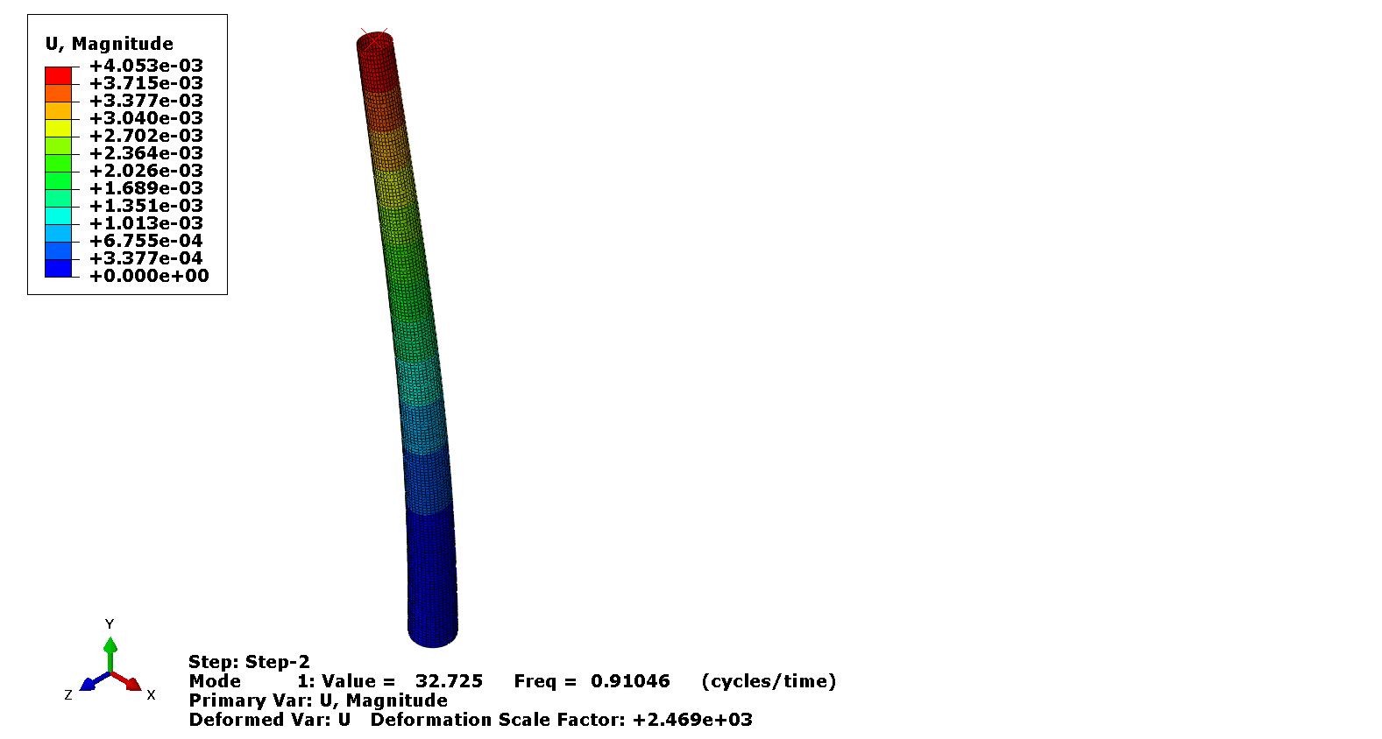

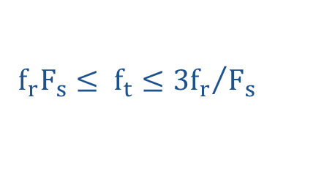
Results and Discussion
Modal Frequencies and Shapes
$$f_{r}F_{s}≤ f_{t}≤{{3f}_{r}}/{F_{s}}$$
$$0.280 Hz≤ f_{t}≤ 0.762 Hz$$
The tower is categorized as a Stiff Tower. So, the tower is fully free from the occurrence of resonance during the start-up and shutdown process of the rotor
1st modal frequency = 0.91 Hz

Slide 62
Final Output

Slide 63
Conclusions
  Increasing the base diameter with reducing the shell thickness along its height is an effective approach to optimize the mass of the Tower. Final mass = 400.50 t
  Mass of Tower increases around 21% due to Tropical Class
  Earthquake loading associated with z = 0.12 is not prominent compared to wind loading for OWT tower in the southern part of Bangladesh.
  Limitations:
    Integration with Monopile
    Absence of Door Opening
    Absence of 10-nodeed C3D10 continuum finite element (Abaqus)
    Absence of 8-noded solid elements (Staad.Pro)
    Rotor-assembly installed on the center of tower top
    Siemens SWT 2.3-93 MW WT is used which is not perfectly matched with new specifications of IEC Class Tropical (IEC 61400-1 Ed. 4.0, 2019)
    Vessel Collision

Slide 64


Slide 65
Thanks

