Slide 1
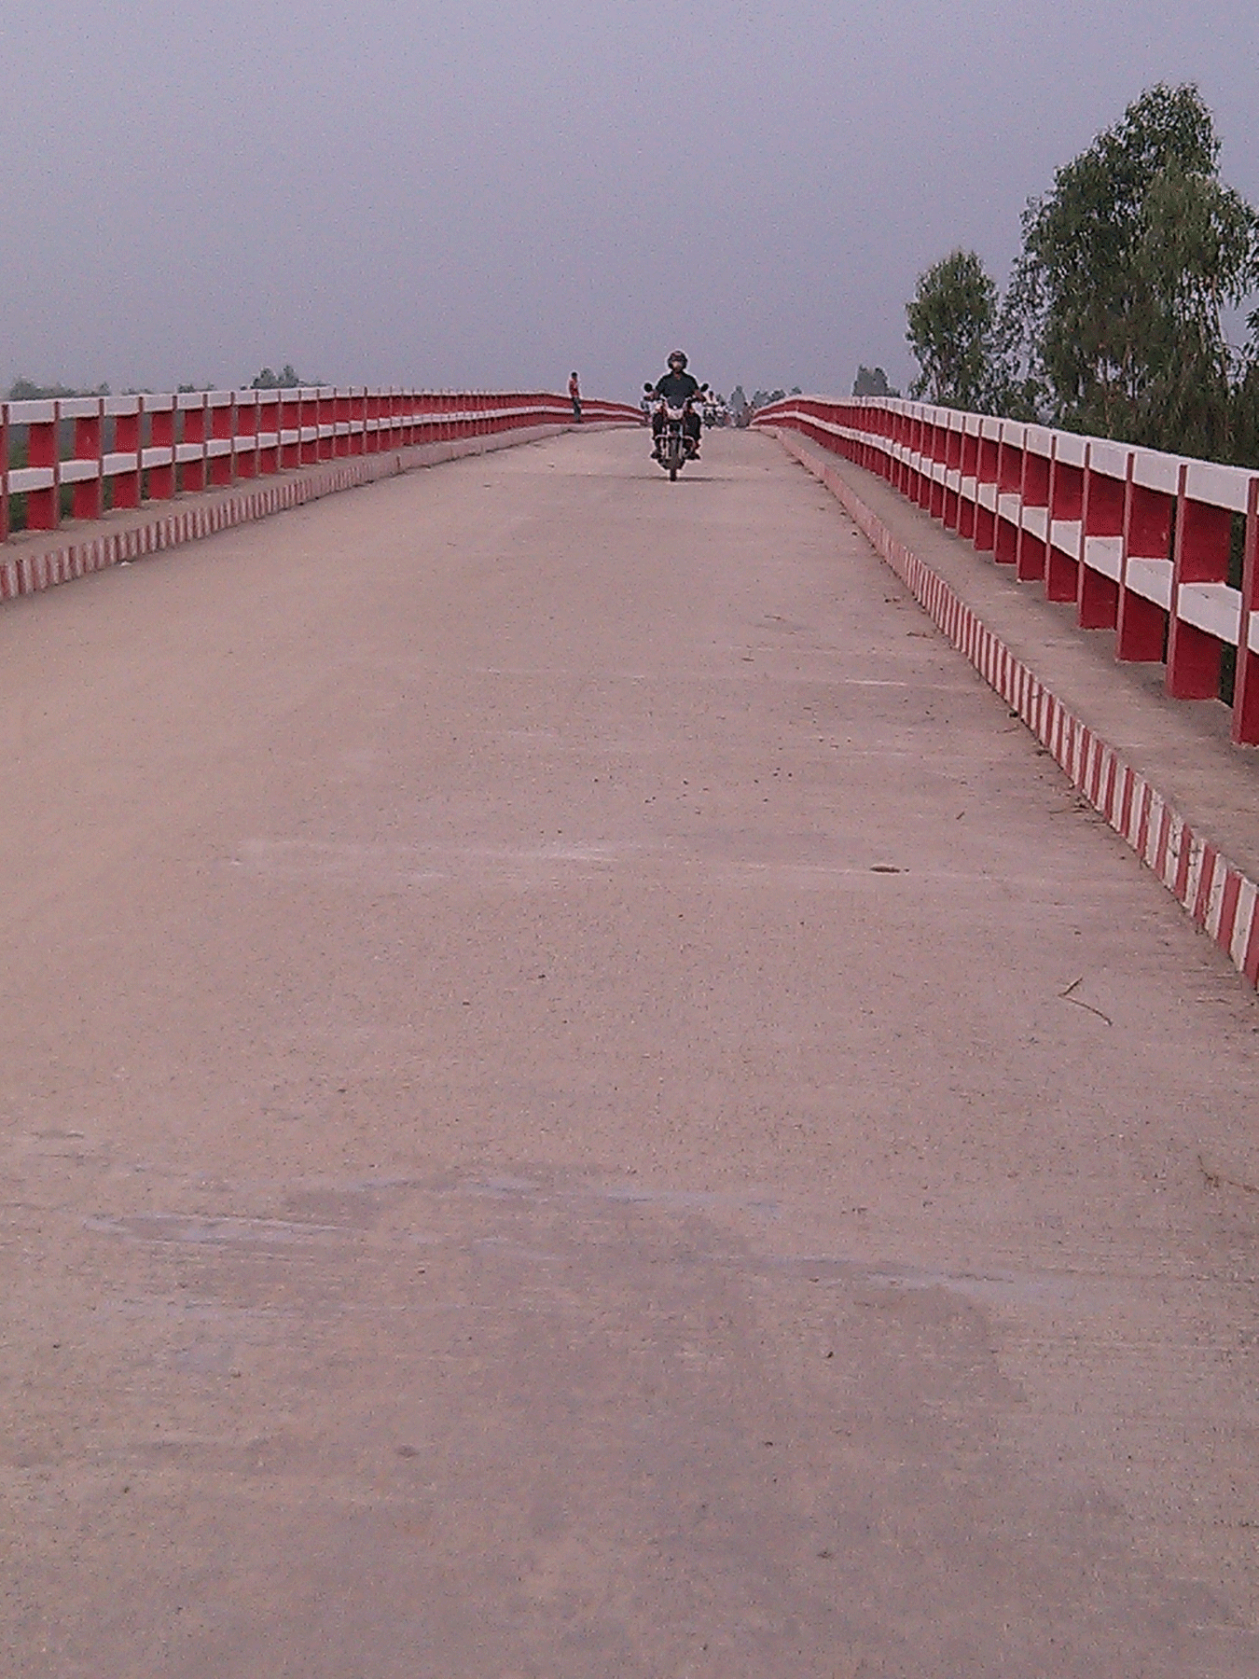
Completed 400.225 m.Long PC Girder Bridge on Amaitara- Agradigon Road over Atrai River under Dhamoirhat upazila

