Slide 1
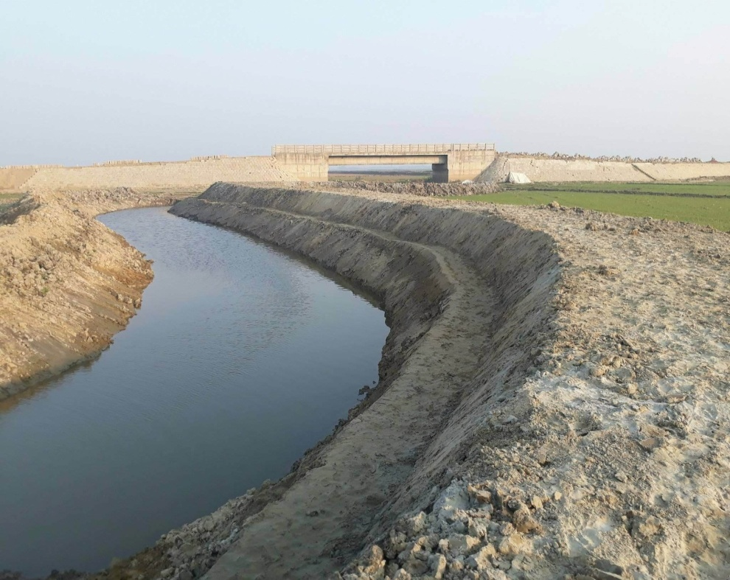
Khal Excavation
Re excavation of Shapla Khal , Upazila : Azmiriganj , Dist : Habiganj

