Slide 1
Welcome
Md. Zahid Hossain Khan
[BSc (RUET); MEnggSc (UM, Malaysia); MBA (IBA, RU)
Executive Engineer (C.C.)
Khulna Division, Khulna
Local Government Engineering Department (LGED)
21 October 2021
Notes:
আমি মোঃ জাহিদ হোসেন খান
আমার প্রেজেন্টেসনের এই পর্বে অদ্যকার সভার সভাপতি ও শ্রদ্ধেয় প্রধান প্রকৌশলী জনাব আব্দুর রশীদ খান স্যার সহ সকলকে স্বাগত জানাই।
প্রজেন্টেশনের শুরুতেই আমাকে উচ্চতর ডিগ্রি অর্জনের সুযোগ দানের জন্য আমি ক্রতজ্ঞতা গাপন করছি এলজিইডি’র প্রতি, শ্রধ্যেয় প্রধান প্রকৌশলী মহোদয়ের প্রতি এবং প্রকল্প পরিচালক ও অতিঃ প্রঃ প্রকৌঃ জনাব একেএম লুতফর রহমান স্যারের প্রতি।

Slide 2



Course introduction
Program : Master of Engineering Science
Mode of Study : Research
Field of Research : Transportation Engineering
University : University of Malaya, Malaysia
Study progress : Thesis evaluation under process.
Finance : LGED’s Human Resources Development and Capacity Building Project
2

Slide 3
Performance of Crumb Rubber Modified ACW14 Mixes with Reclaimed Asphalt Pavement and Waste Engine Oil as Rejuvenator
Thesis title

Slide 4
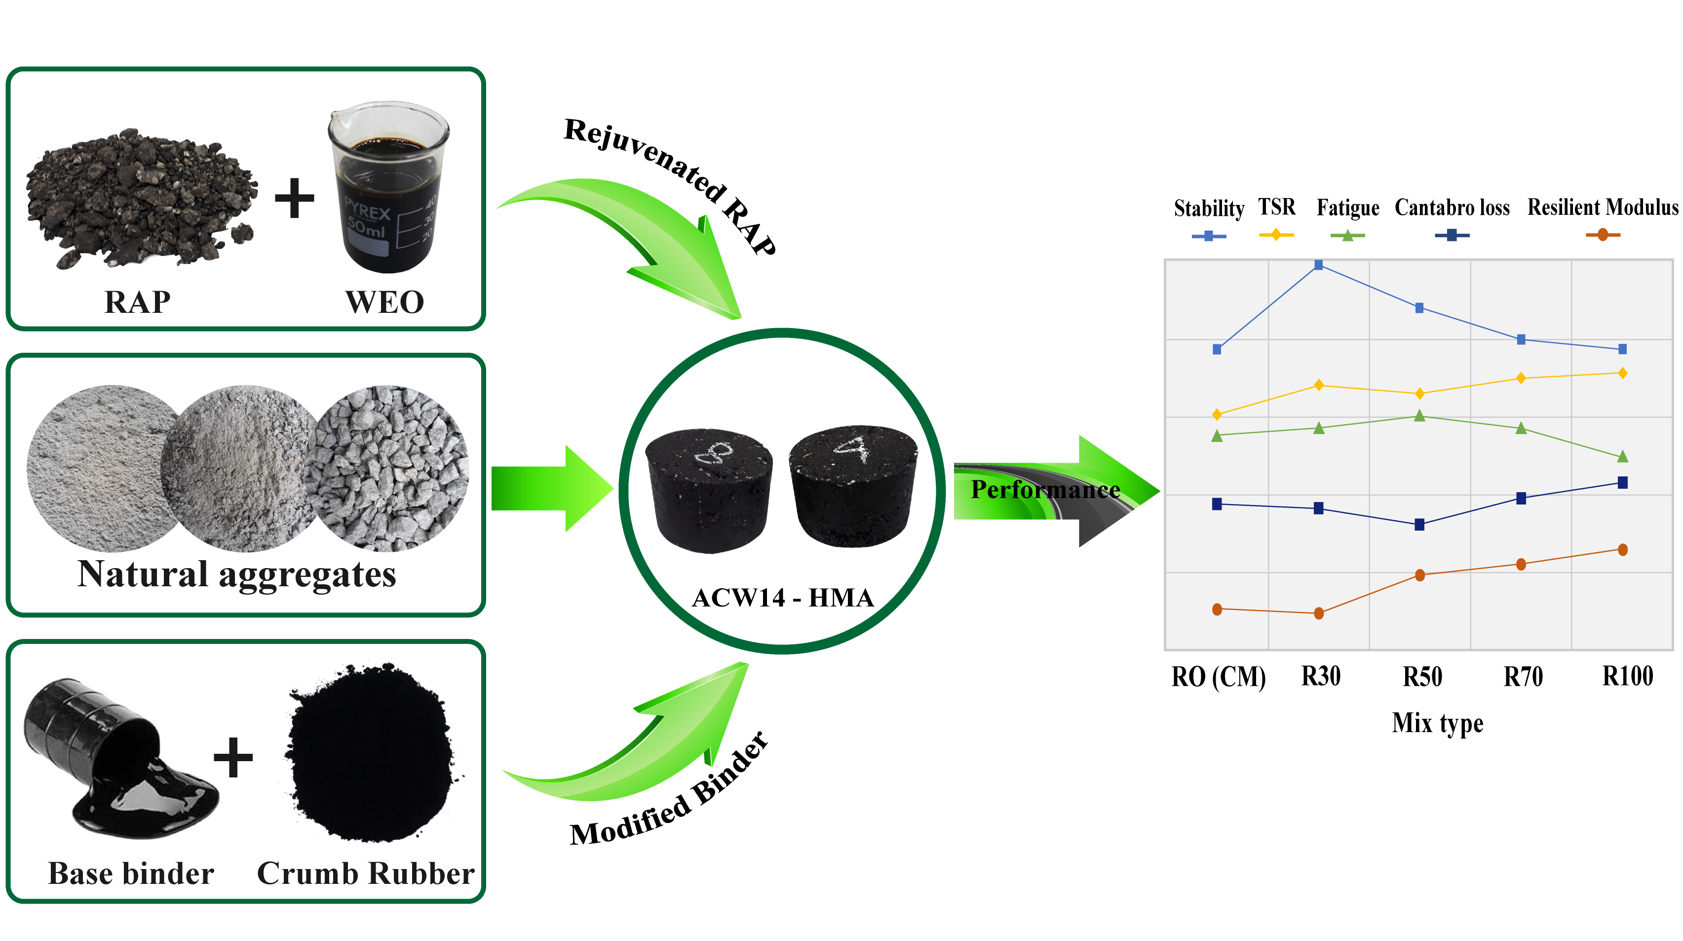
Graphical abstract
4

Slide 5
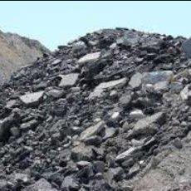
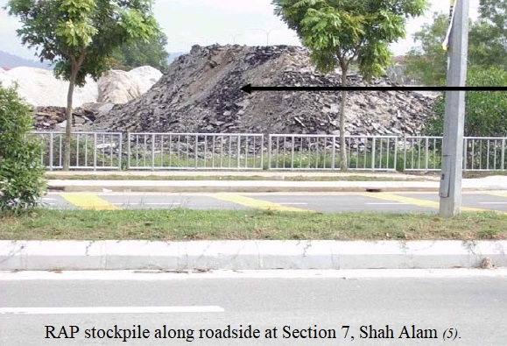
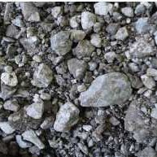
RAP
Reclaimed Asphalt Pavement (RAP)
5

Slide 6
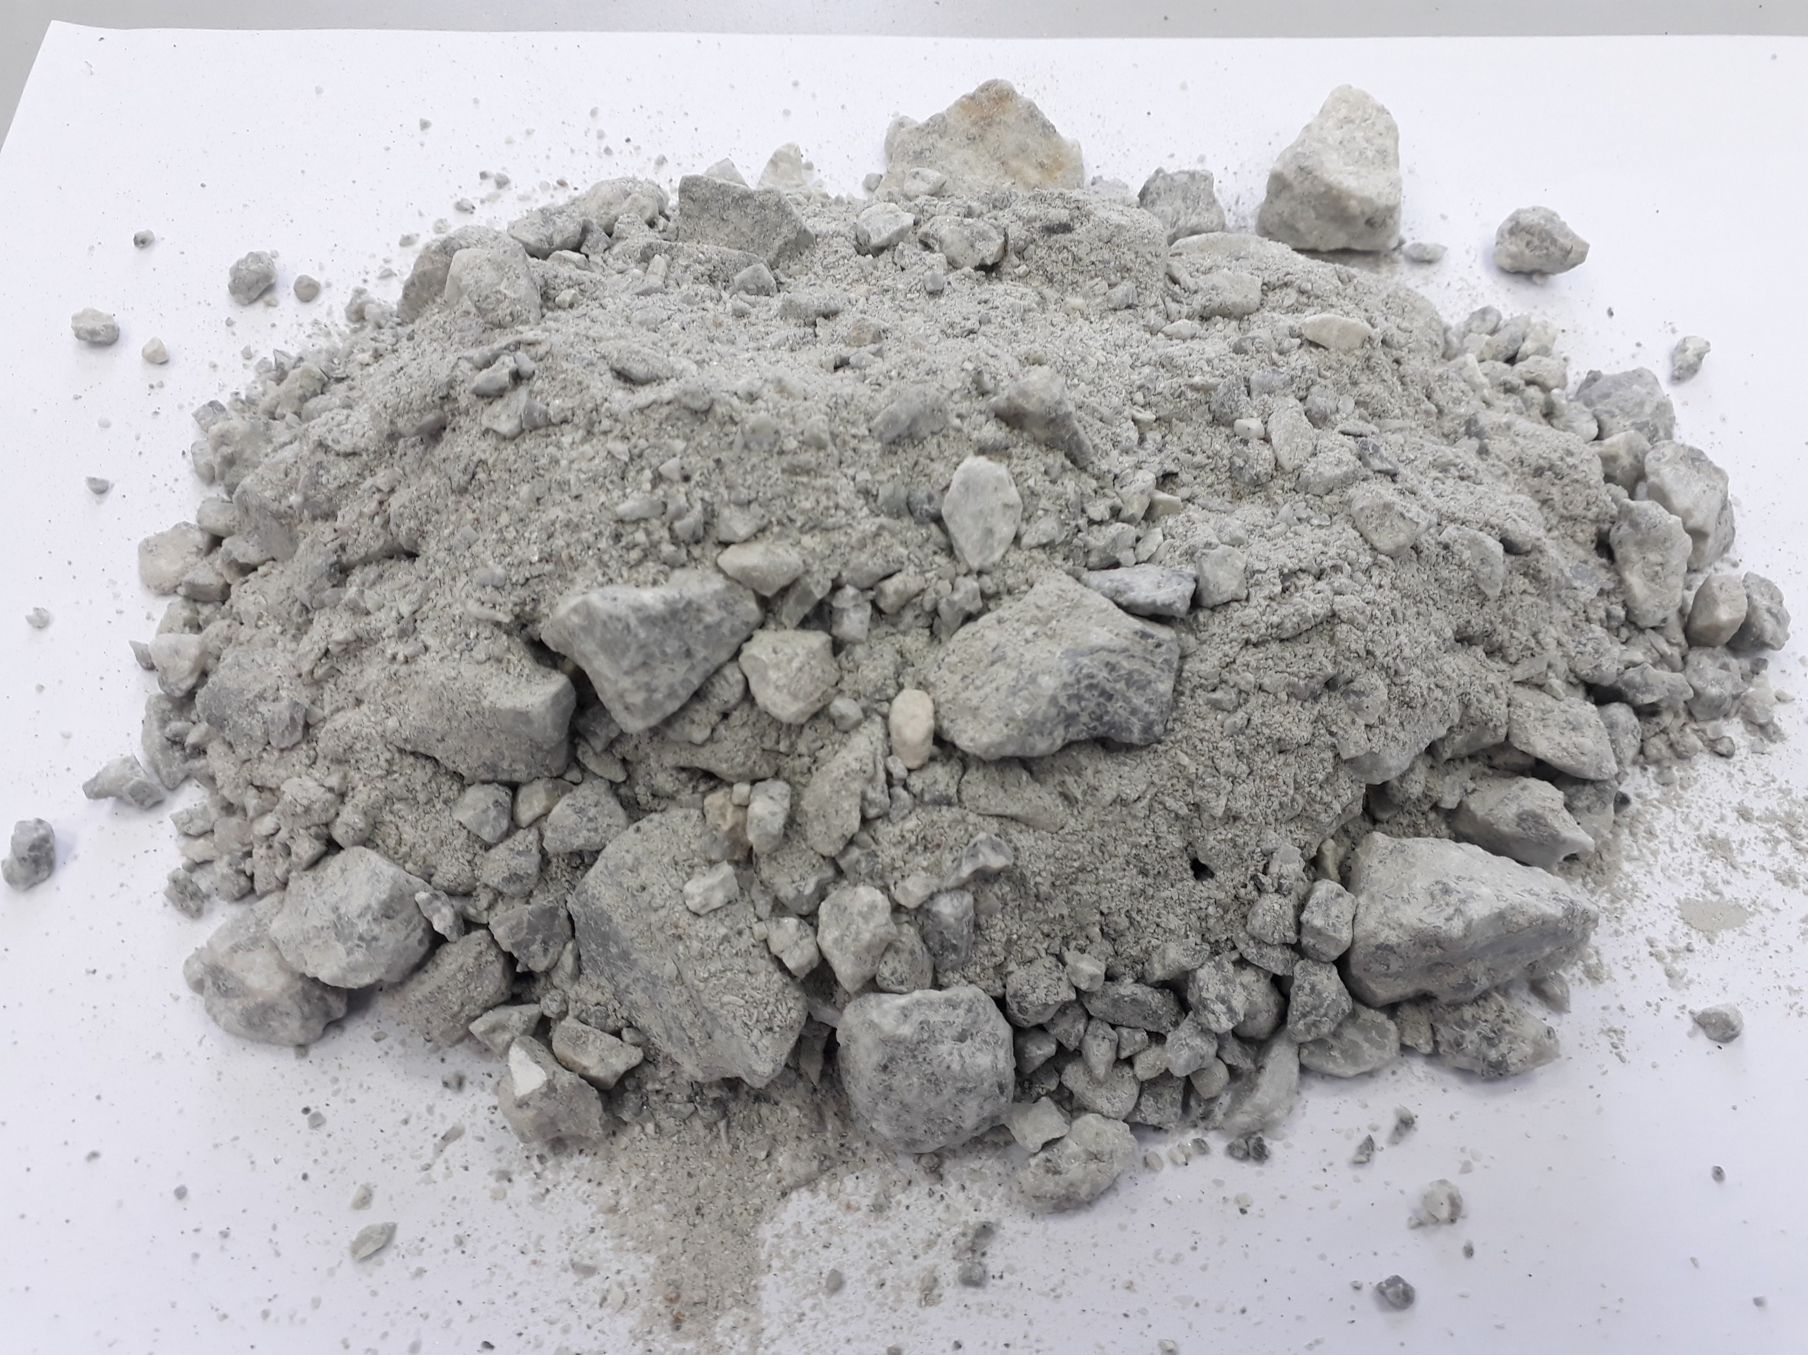
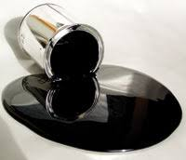
RAP
Reclaimed Asphalt Pavement (RAP)
Suitable substitute for
Natural aggregate
and Binder
6

Slide 7
RAP
Reclaimed Asphalt Pavement (RAP)
The challenges are
1. Restoration of it’s aged binder properties
2. Gradation
7

Slide 8
WEO
Waste Engine Oil (WEO)
Rejuvenator
8

Slide 9

WEO
Waste Engine Oil (WEO)
Why WEO as a rejuvenator?
It can restore the aged binder’s properties.
It softens the aged binder and improves the workability.
It’s comparatively available and cheaper.
9

Slide 10
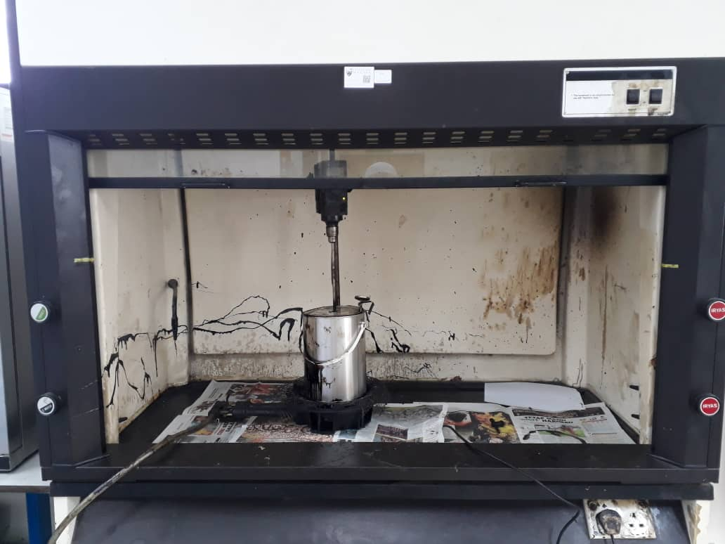
CRM
Propeller mixer:
Speed = 200 rpm
Time = 2 hours
Temperature = 160°C.
CRM can enhance the mechanical properties of the binder
Base binder
(60-70 pen grade)
Crumb Rubber Modifier (CRM)
6%; #80 mesh size
10

Slide 11
Natural aggregates
11

Slide 12
Research aim
To explore an integrated use of high RAP content with rejuvenator and binder modifier in HMA design.
12

Slide 13
Research Objectives
To determine the optimum binder content (OBC).
To analyze Marshall parameters.
To investigate the mechanical performances of HMA mixes.
13

Slide 14
HMA
14

Slide 15
Hma performances
15

Slide 16
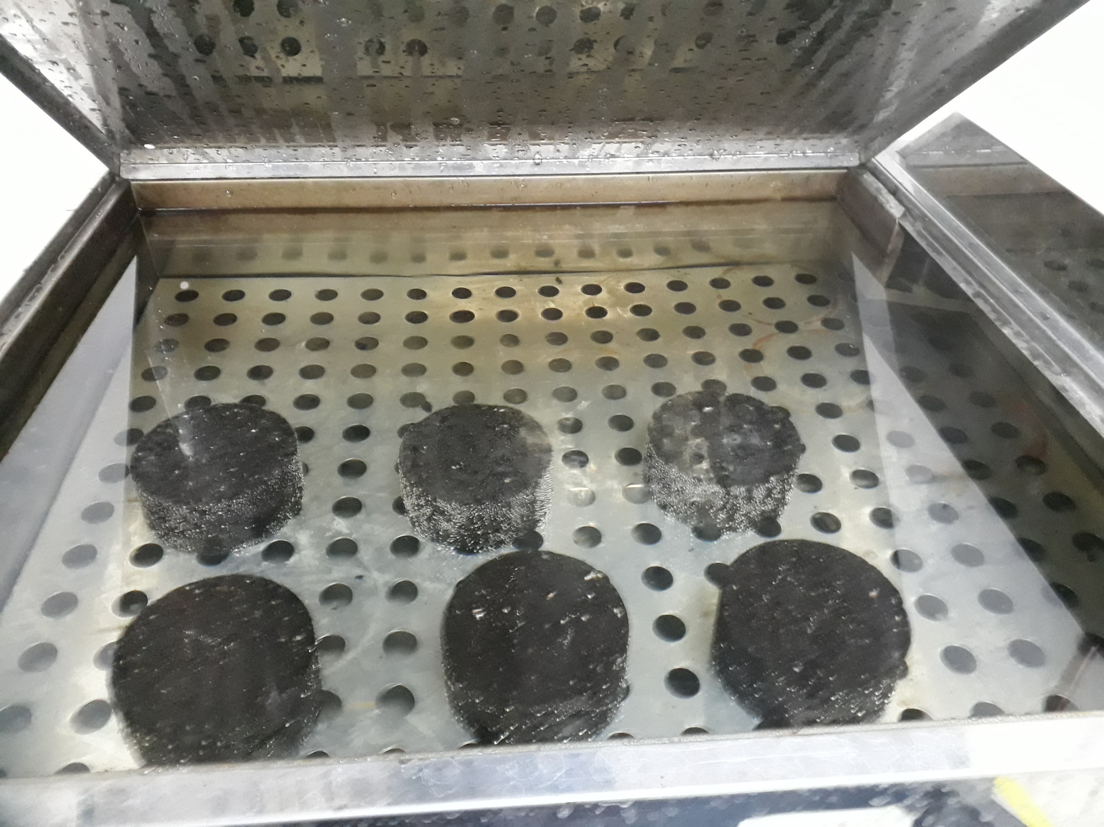
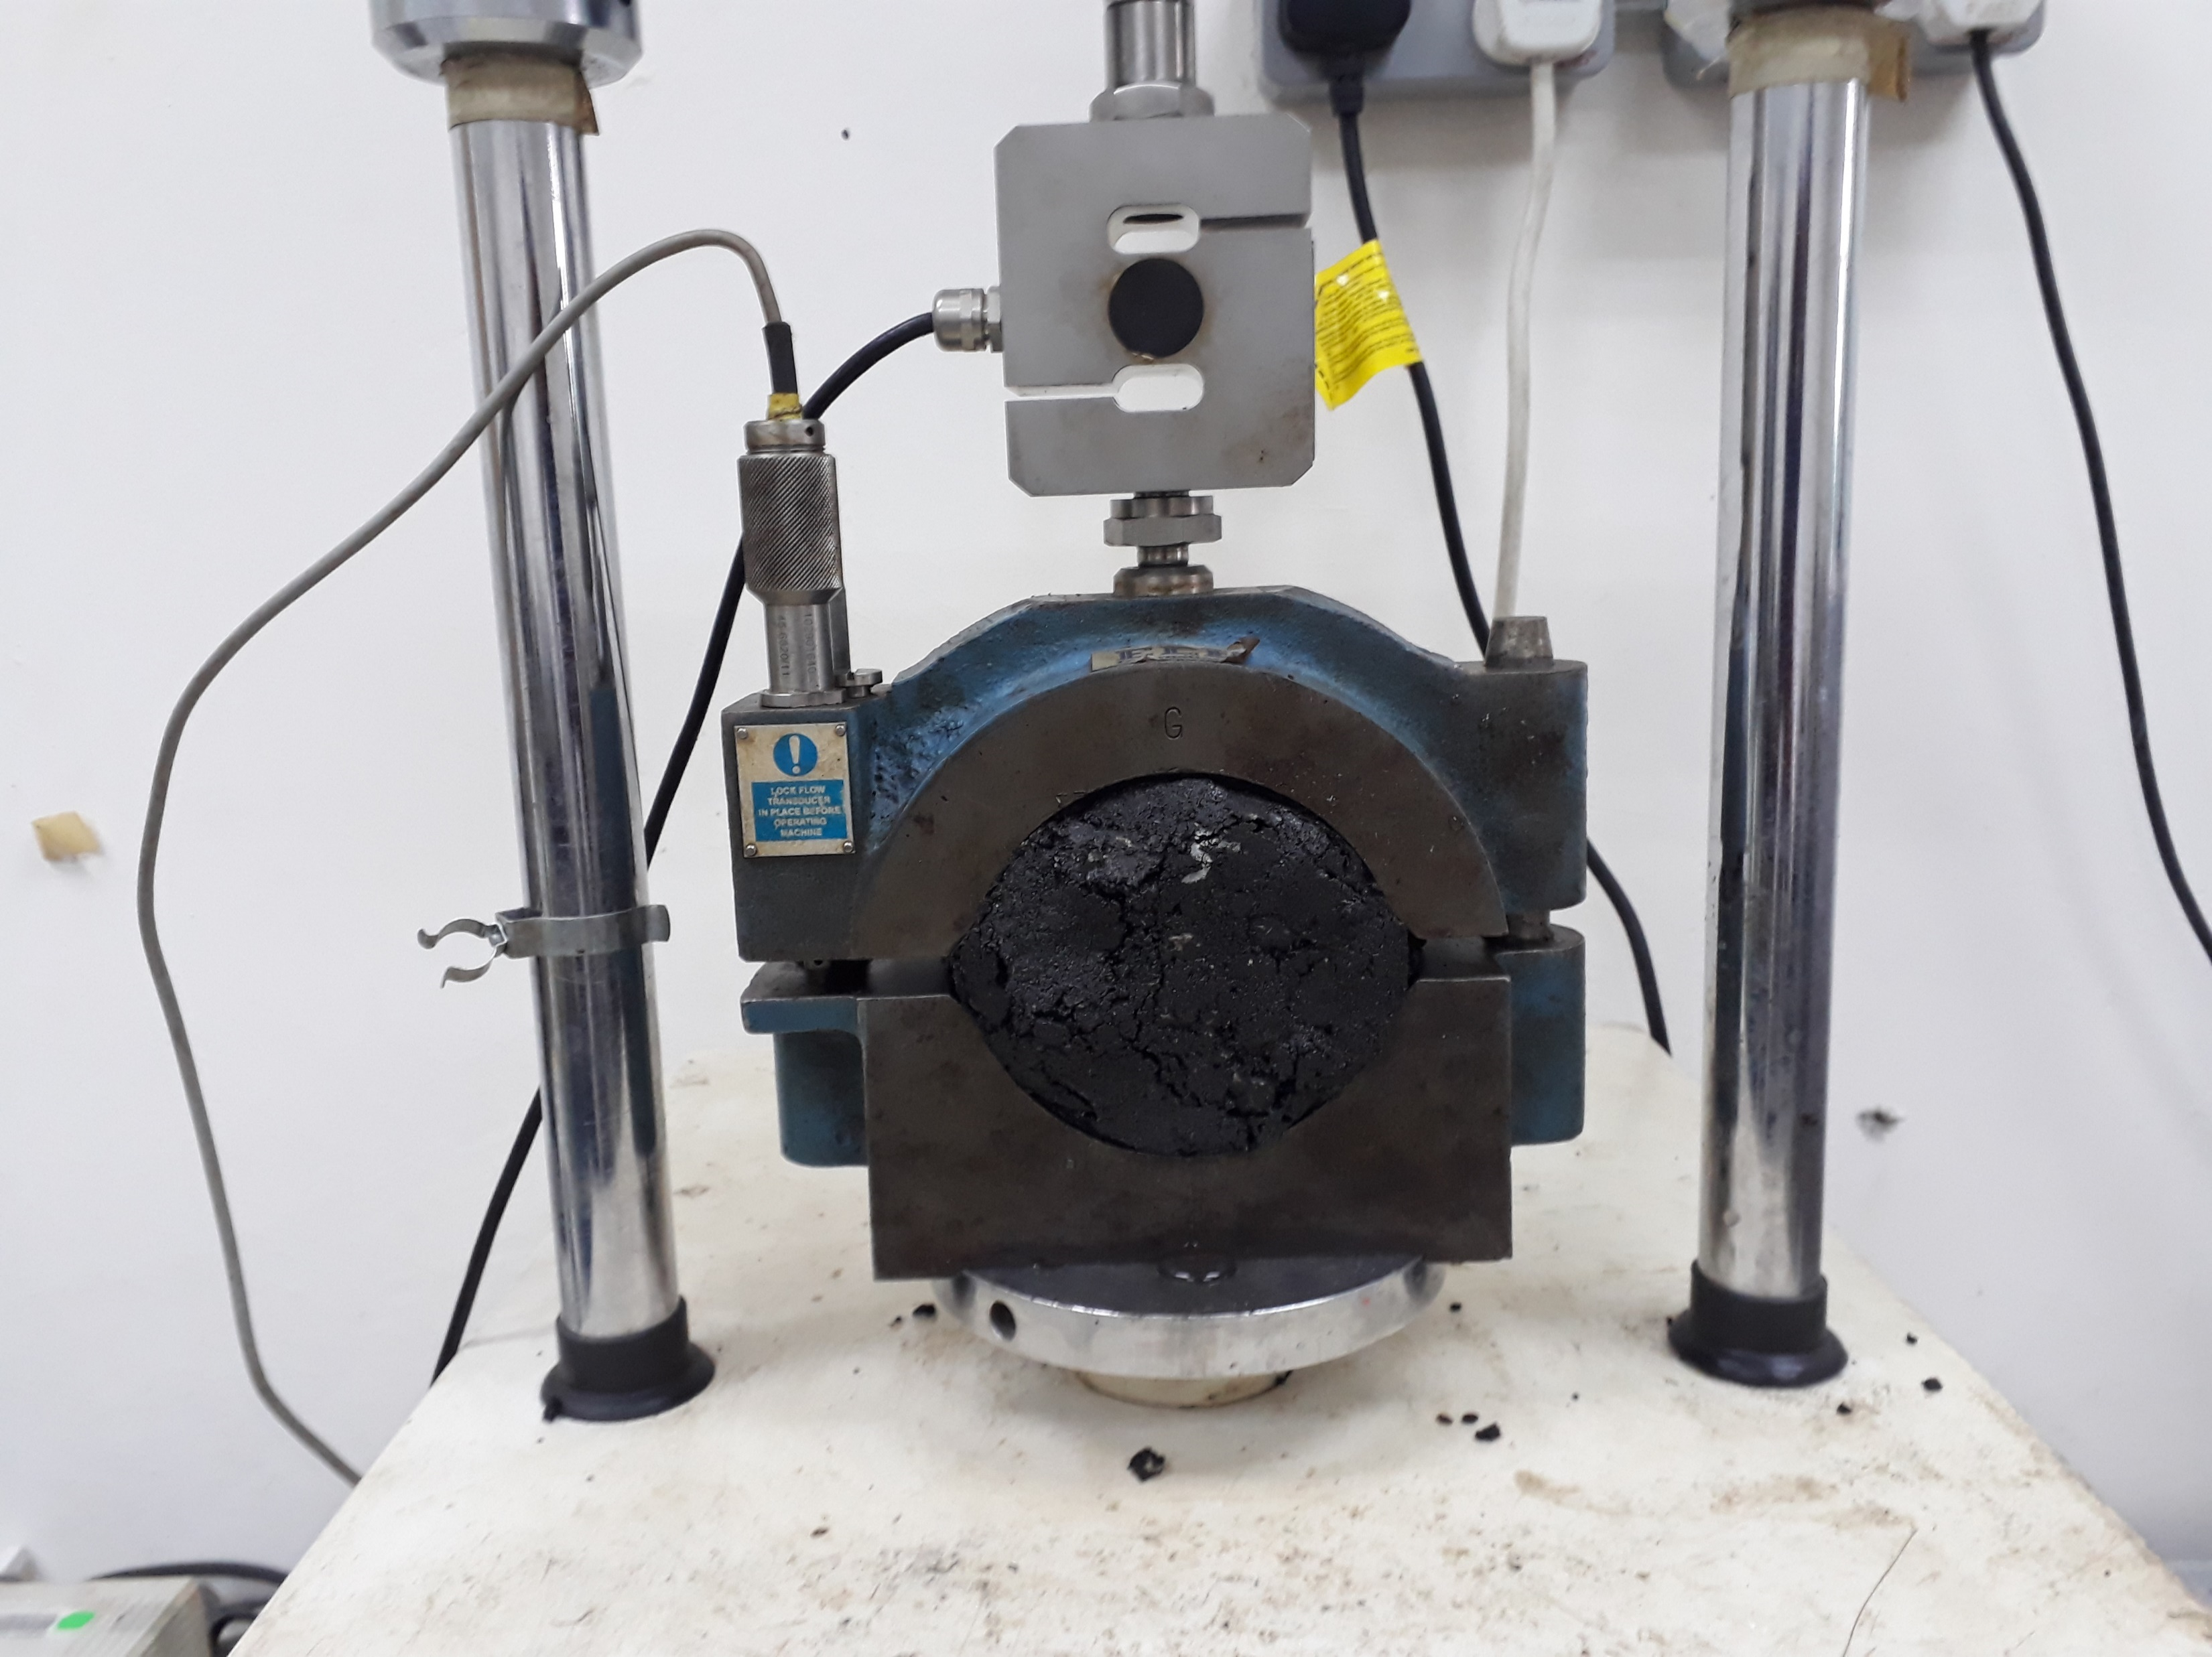
Hma performances
Stability
16

Slide 17
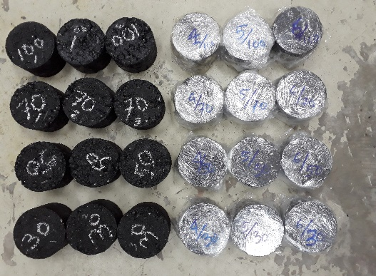
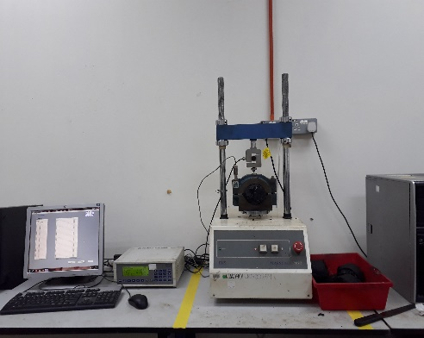
Hma performances
TSR (Tensile Strength Ratio)
17

Slide 18
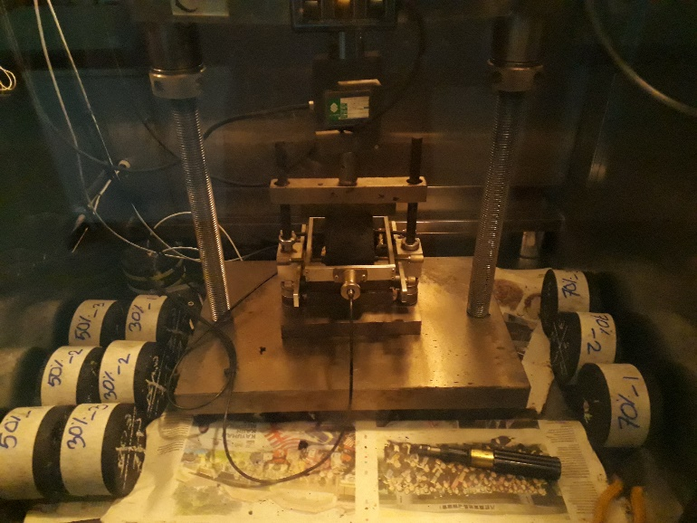
Hma performances
Indirect Tensile Fatigue Test (ITFT)
18

Slide 19
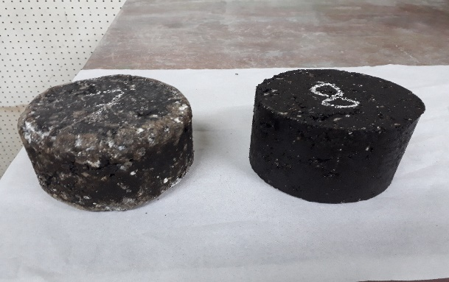
Hma performances
Cantabro Loss
19

Slide 20
Hma performances
Resilient Modulus
20

Slide 21
Hma overall performances
21

Slide 22
Economic benefits
R100 mix needs 79.7% lower binder than the R0 mix
So, the amount of binder used in RAP mixes was drastically reduced.
Therefore, high content RAP would lead to significant economic gain.
22

Slide 23
Conclusion
The collective performance of all RAP mixes was higher than the control mix.
Therefore, 100% RAP mix can be used.
23

Slide 24
Study Contribution (Page: 1/5)
Reclaimed asphalt pavement (RAP) refers to removed and/or reprocessed pavement materials containing asphalt and aggregates. Using RAP as a suitable substitute for natural aggregate and binder offers an energy-saving and cost-effective approach to enhancing the performance of the asphalt mix. Realizing the potential use of RAP as a promising recycling technique, many countries seek to recycle and use RAP as part of the global effort to address the rising challenge of climate change and contribute to a sustainable environment as well as tackle the increasing cost of materials and the continuous depletion of natural resources.
24

Slide 25
Study Contribution
Study Contribution (Page: 2/5)
In recent decades, the fast-paced global development and urbanization have led to the surge in demand for natural aggregates (NA) in road construction. But the nature of NA production is very much harmful to the environment, which refers to floating global environmental issues. So, RAP is considered one of the key solutions to address critical challenges of climate change and contribute to a sustainable environment, especially in the road construction industry. Several studies have revealed that using RAP could reduce harmful gas emissions and production costs by as much as 35% and 70%, respectively.
24

Slide 26
Study Contribution
Study Contribution (Page: 3/5)
Various approaches have been proposed to use RAP in the road construction industry. Meanwhile, most road construction practices are primarily limited to low-content RAP for lower-value applications, such as a base layer, road shoulder, and rural roads. But no uniform RAP recycling standard can be used as a guideline for a broader application of high-content RAP in HMA design. Therefore, the lack of awareness and non-standard recycling requirements contributes to many countries' limited application of high RAP.
24

Slide 27
Study Contribution
Study Contribution (Page: 4/5)
My study aimed to characterize the different percentages of RAP mixes to prepare five HMA mixes. A total of five different HMA mixes were prepared where a replacement of 0%, 30%, 50%, 70%, and 100% RAP aggregates was incorporated in the mix. The RAP was incorporated with two waste materials: crumb rubber (CR) as a binder modifier and waste engine oil (WEO) as a rejuvenator. The Marshall method was used to determine the optimum binder content. Finally, four mechanical performance tests of the five HMA mixes were conducted and analyzed. Overall, the collective performance of all RAP mixes was higher than the control mix (0% RAP).
24

Slide 28
Study Contribution
Study Contribution (Page: 5/5)
The findings from this study would provide a better understanding of using a high content of RAP in HMA design. This study could serve as a reference to provide a novel idea and concept for using high-content RAP. The outcomes of this study would also benefit society in waste recycling for essential conservation and preservation of the environment. This study also reflects the goals of SDG 9 and SDG 12 with their corresponding indicators 9.4.1 and 12.5.1, respectively.
24

Slide 29
Article Publication During Study 1/2
Article title: Performance of High Content Reclaimed Asphalt Pavement (RAP) in Asphaltic Mix with Crumb Rubber Modifier and Waste Engine Oil as Rejuvenator.
Writer: Khan, M. Z. H., Koting, S., Katman, H. Y. B., Ibrahim, M. R., Babalghaith, A. M., & Asqool, O.
Journal name and status: Applied Sciences, 11(11), 5226. doi:org/10.3390/app11115226. (ISI indexed). (2021). (Published).
2. Article title: Influence of Waste Oils on the Properties of the Extracted Aged Binder and Dosage Optimisation [Paper presentation].
Writer: Khan, M. Z. H., Babalghaith, A. M., Koting, Ibrahim, M. R., S., Katman, H. Y. B., & Asqool, O.
Journal name and status: International Conference on Architecture and Civil Engineering, Virtual Conference. (Scopus indexed). (2021, August 18). (Published).
26

Slide 30
Article Publication During Study 2/2
Article name: A systematic review of the utilization of waste materials as aggregate replacement in stone matrix asphalt mixes.
Writer: Ali Mohammed Babalghaith; Suhana Koting; Nor Hafizah Ramli Sulong; Md Zahid Hossain Khan; Abdalrhman Milad; Nur Izzi Md. Yusoff; Mohd Rasdan Ibrahim; Abdul Halim Nagor Mohamed.
Journal name and status: Environmental Science and Pollution Research. doi.org/10.1007/s11356-022-19447-w. (ISI indexed). (2021). (Published).
Article title: Optimisation of Crumb Rubber- Modified Binder for Hot-Mix Asphalt Design Containing High Reclaimed Asphalt Pavement and Waste Engine Oil.
Writer: Khan, M. Z. H., Koting, S., Ibrahim, M. R., Babalghaith, A. M., Katman, H. Y. B. & Asqool, O.
Status: Under review.
[Note: Md Zahid Hossain Khan = Khan, M. Z. H.]
26

Slide 31
Thank you

